Slide 1
ENTHUSIASM!
Miss Evans

Slide 2

What is enthusiasm?
Energetic
Excited
Inspired
Interested
Notes:
Does anyone know what the word enthusiasm means?

Slide 3
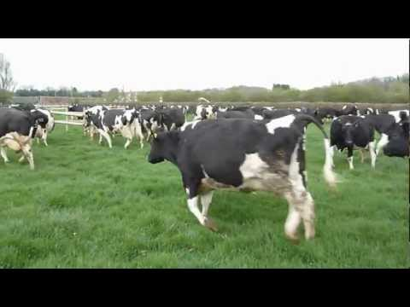
Notes:
This is a video taken by a man who owns a farm. While watching, notice the movement of the cows and try to understand what they are feeling. Watch the video silently and just think!

Slide 4
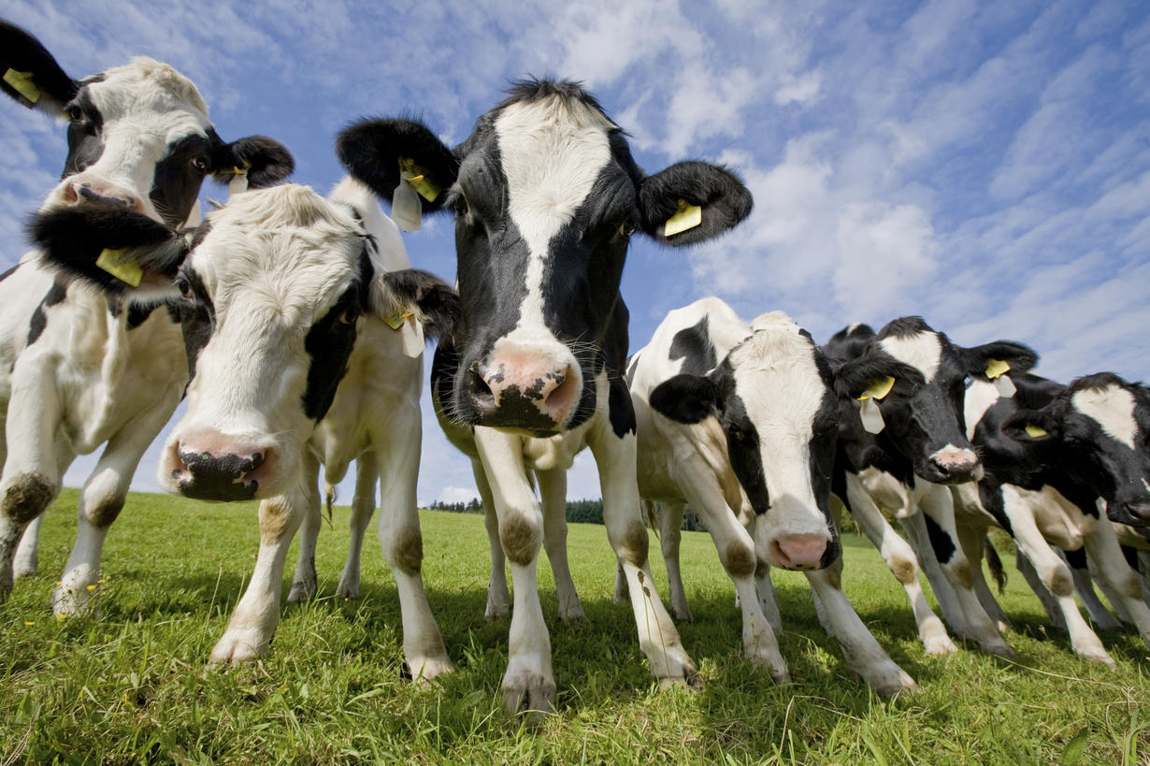
Why are those cows enthusiastic?

Slide 5
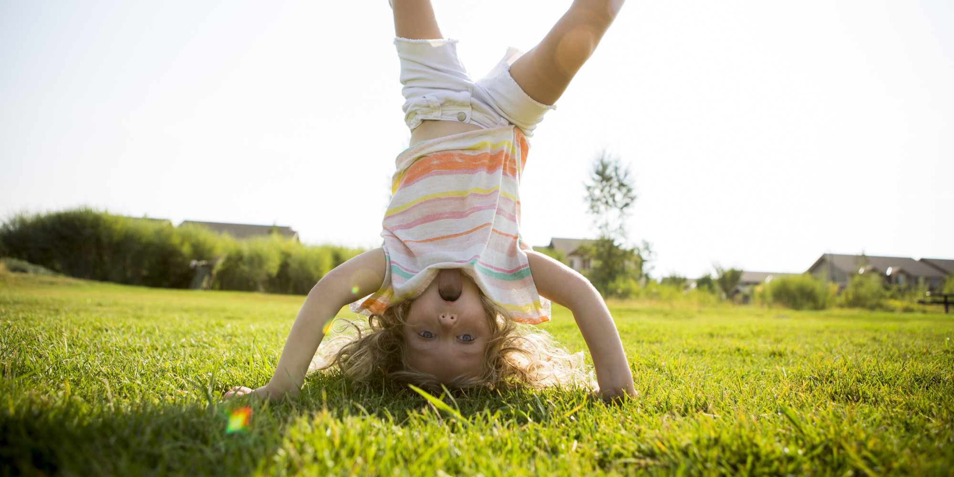
What gives you the feeling of enthusiasm?

Slide 6
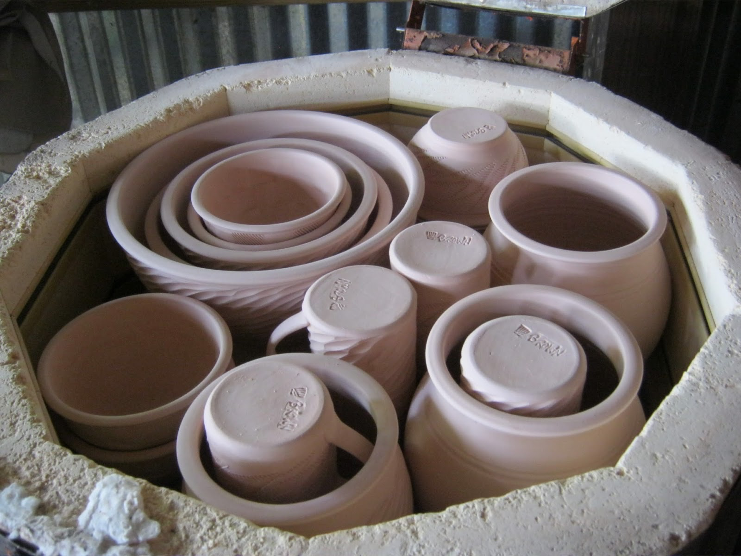
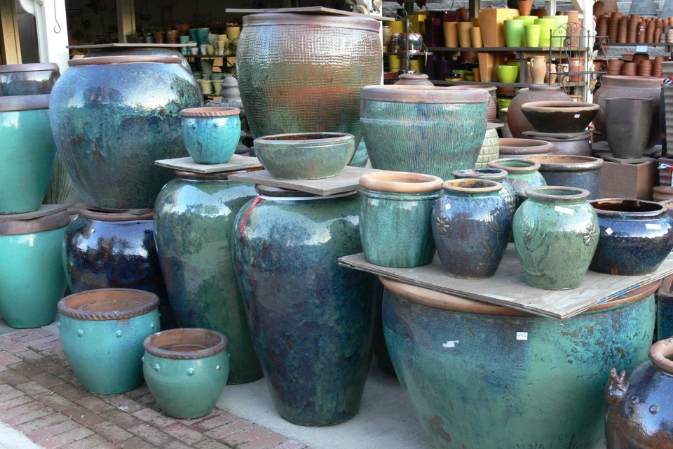
ADDING COLOR
TO CLAY SCULPTURE

Slide 7
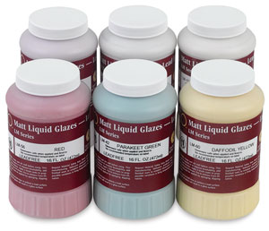
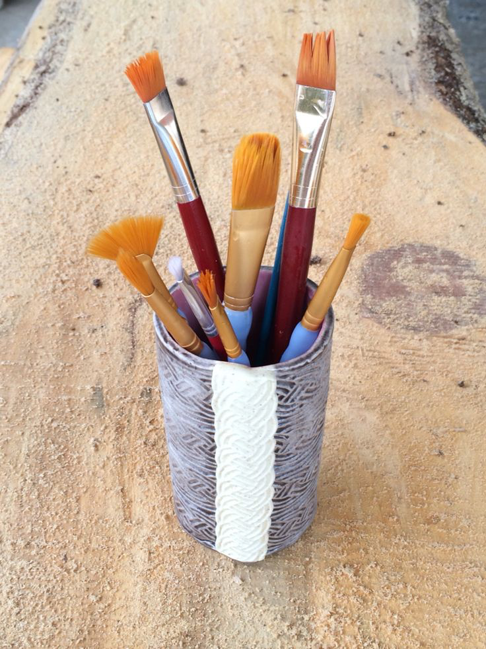
GLAZE
Notes:
Who here has worked with paint? It’s similar to paint because it’s liquid and you use a brush to apply it. But it’s NOT paint. The color we add to clay is called GLAZE. Has anyone heard that word before? What can you tell me about glaze?

Slide 8
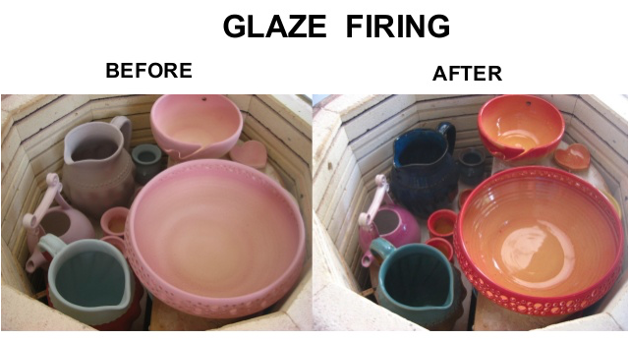
Notes:
It will come out a different, more vibrant, glossy color

Slide 9
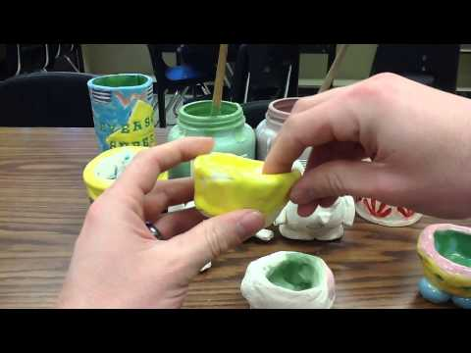

Slide 10
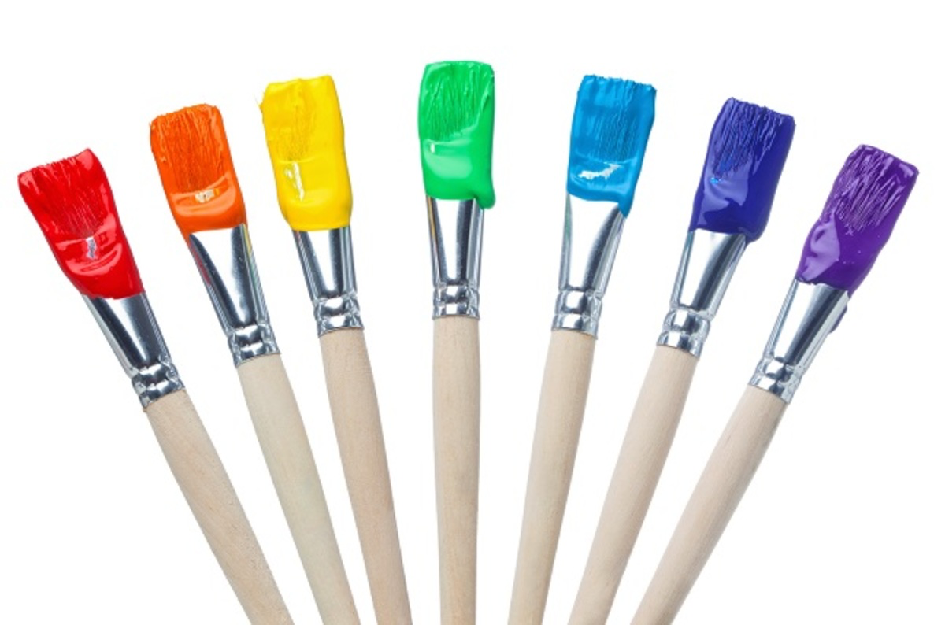
Don’t mix colors together!
Each glaze color has its own brush

Slide 11
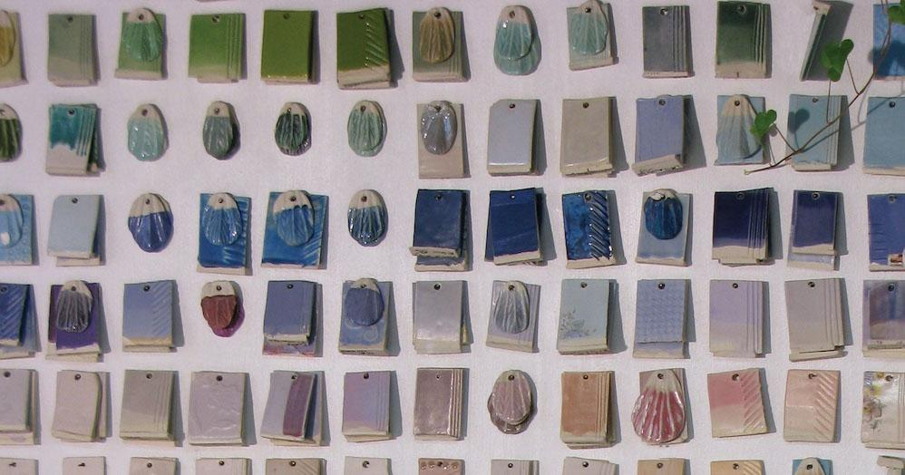
Glaze needs three layers
Notes:
Wait for the glaze to dry and then apply the next layer

Slide 12
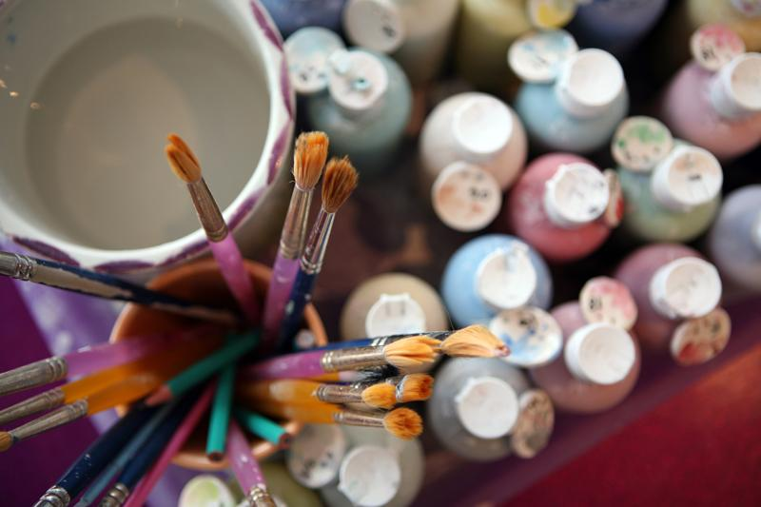
Glaze every part of it!
EXCEPT……..
Notes:
There should be no white space left…. except…..

Slide 13
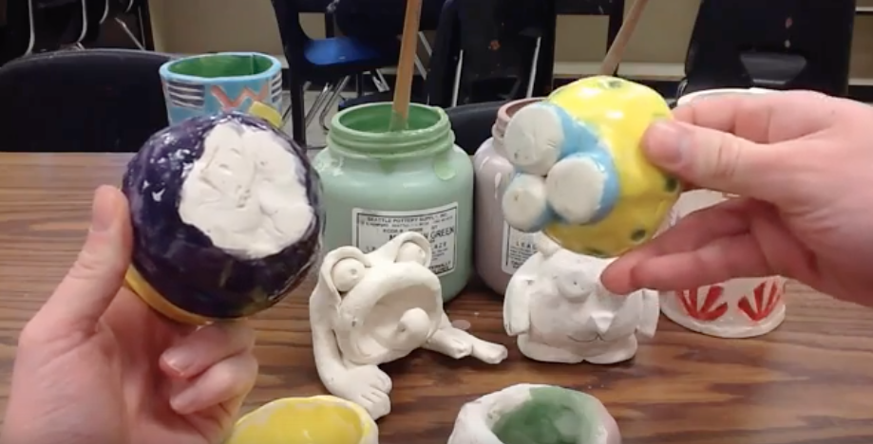
Don’t glaze the bottom!
Notes:
Except don’t put glaze on the bottom! It will stick to the shelf! But we can wipe it off if you accidentally get some on it. ALSO figure out which is the bottom and which is the top of your abstract sculpture.

Slide 14
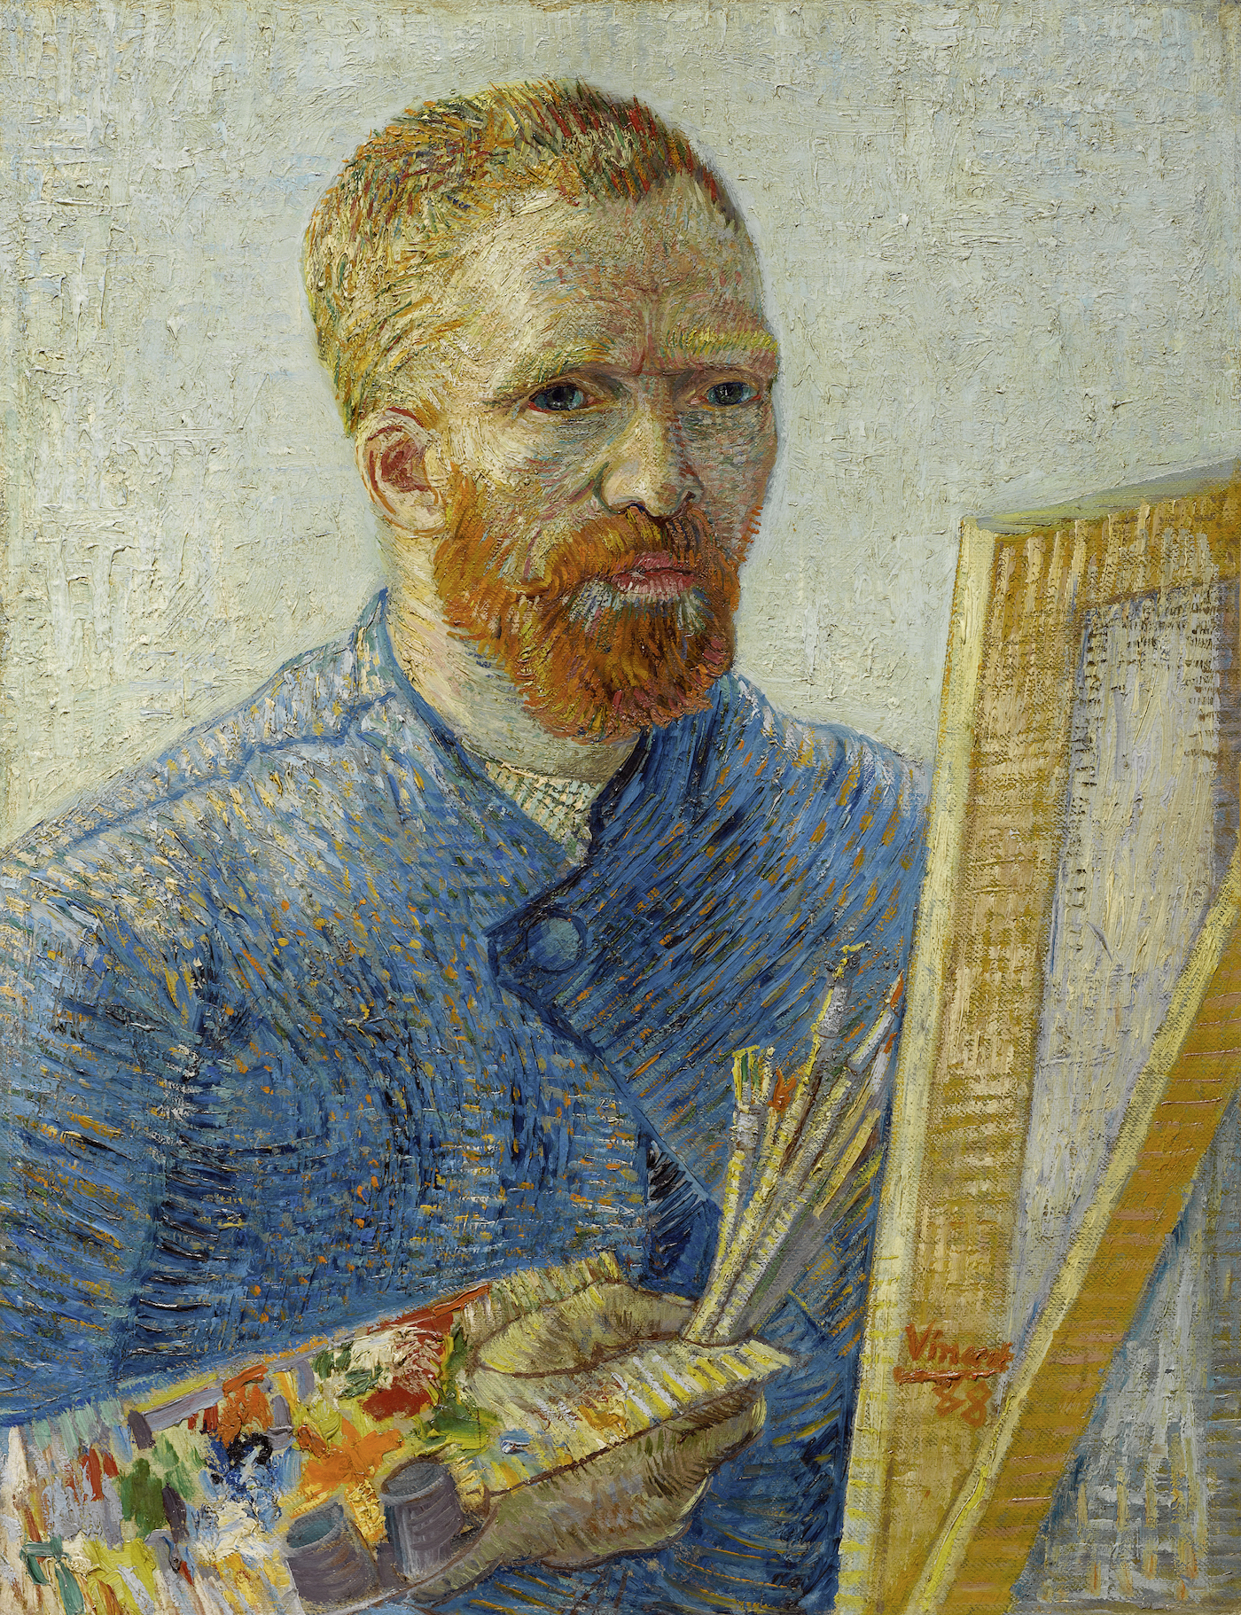
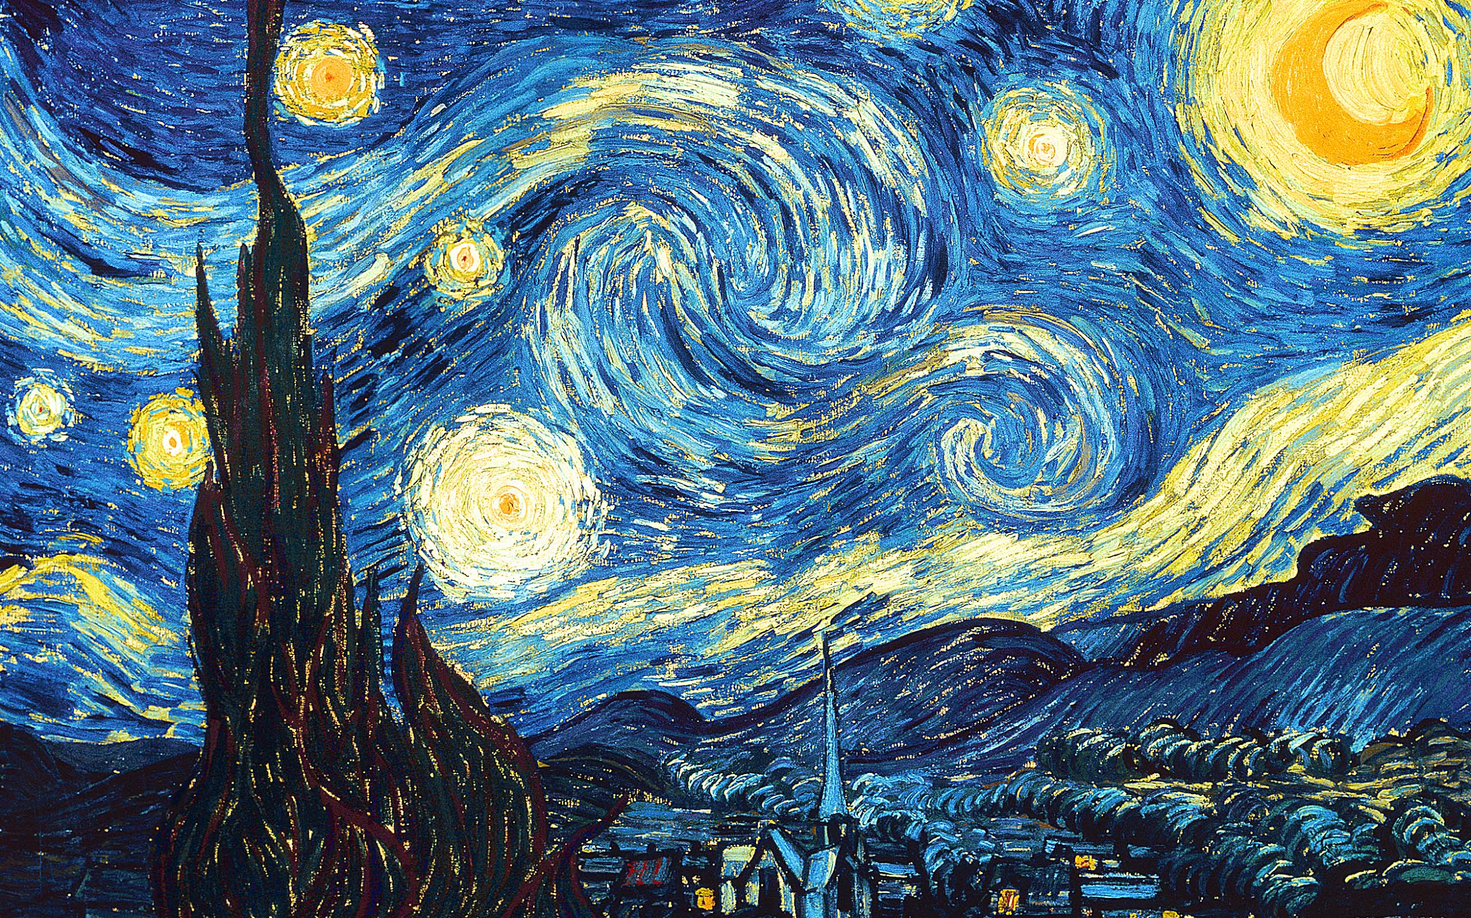
“Color in a painting is like
enthusiasm in life.”
-Vincent Van Gogh

Slide 15
Questions?

