Slide 1
Narrative Collage

Slide 2
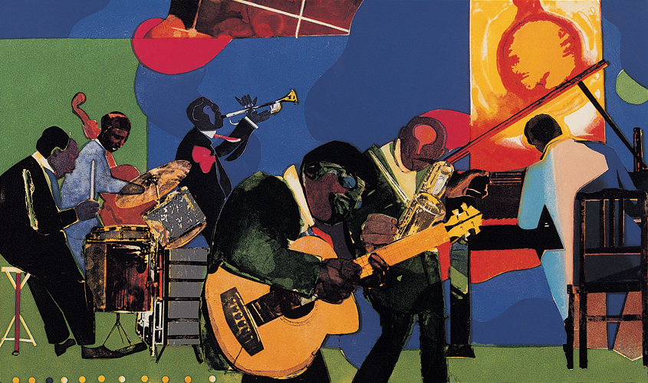
Romare Barden

Slide 3
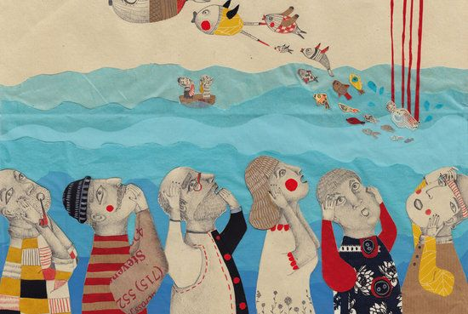
Annalisa Bollini

Slide 4
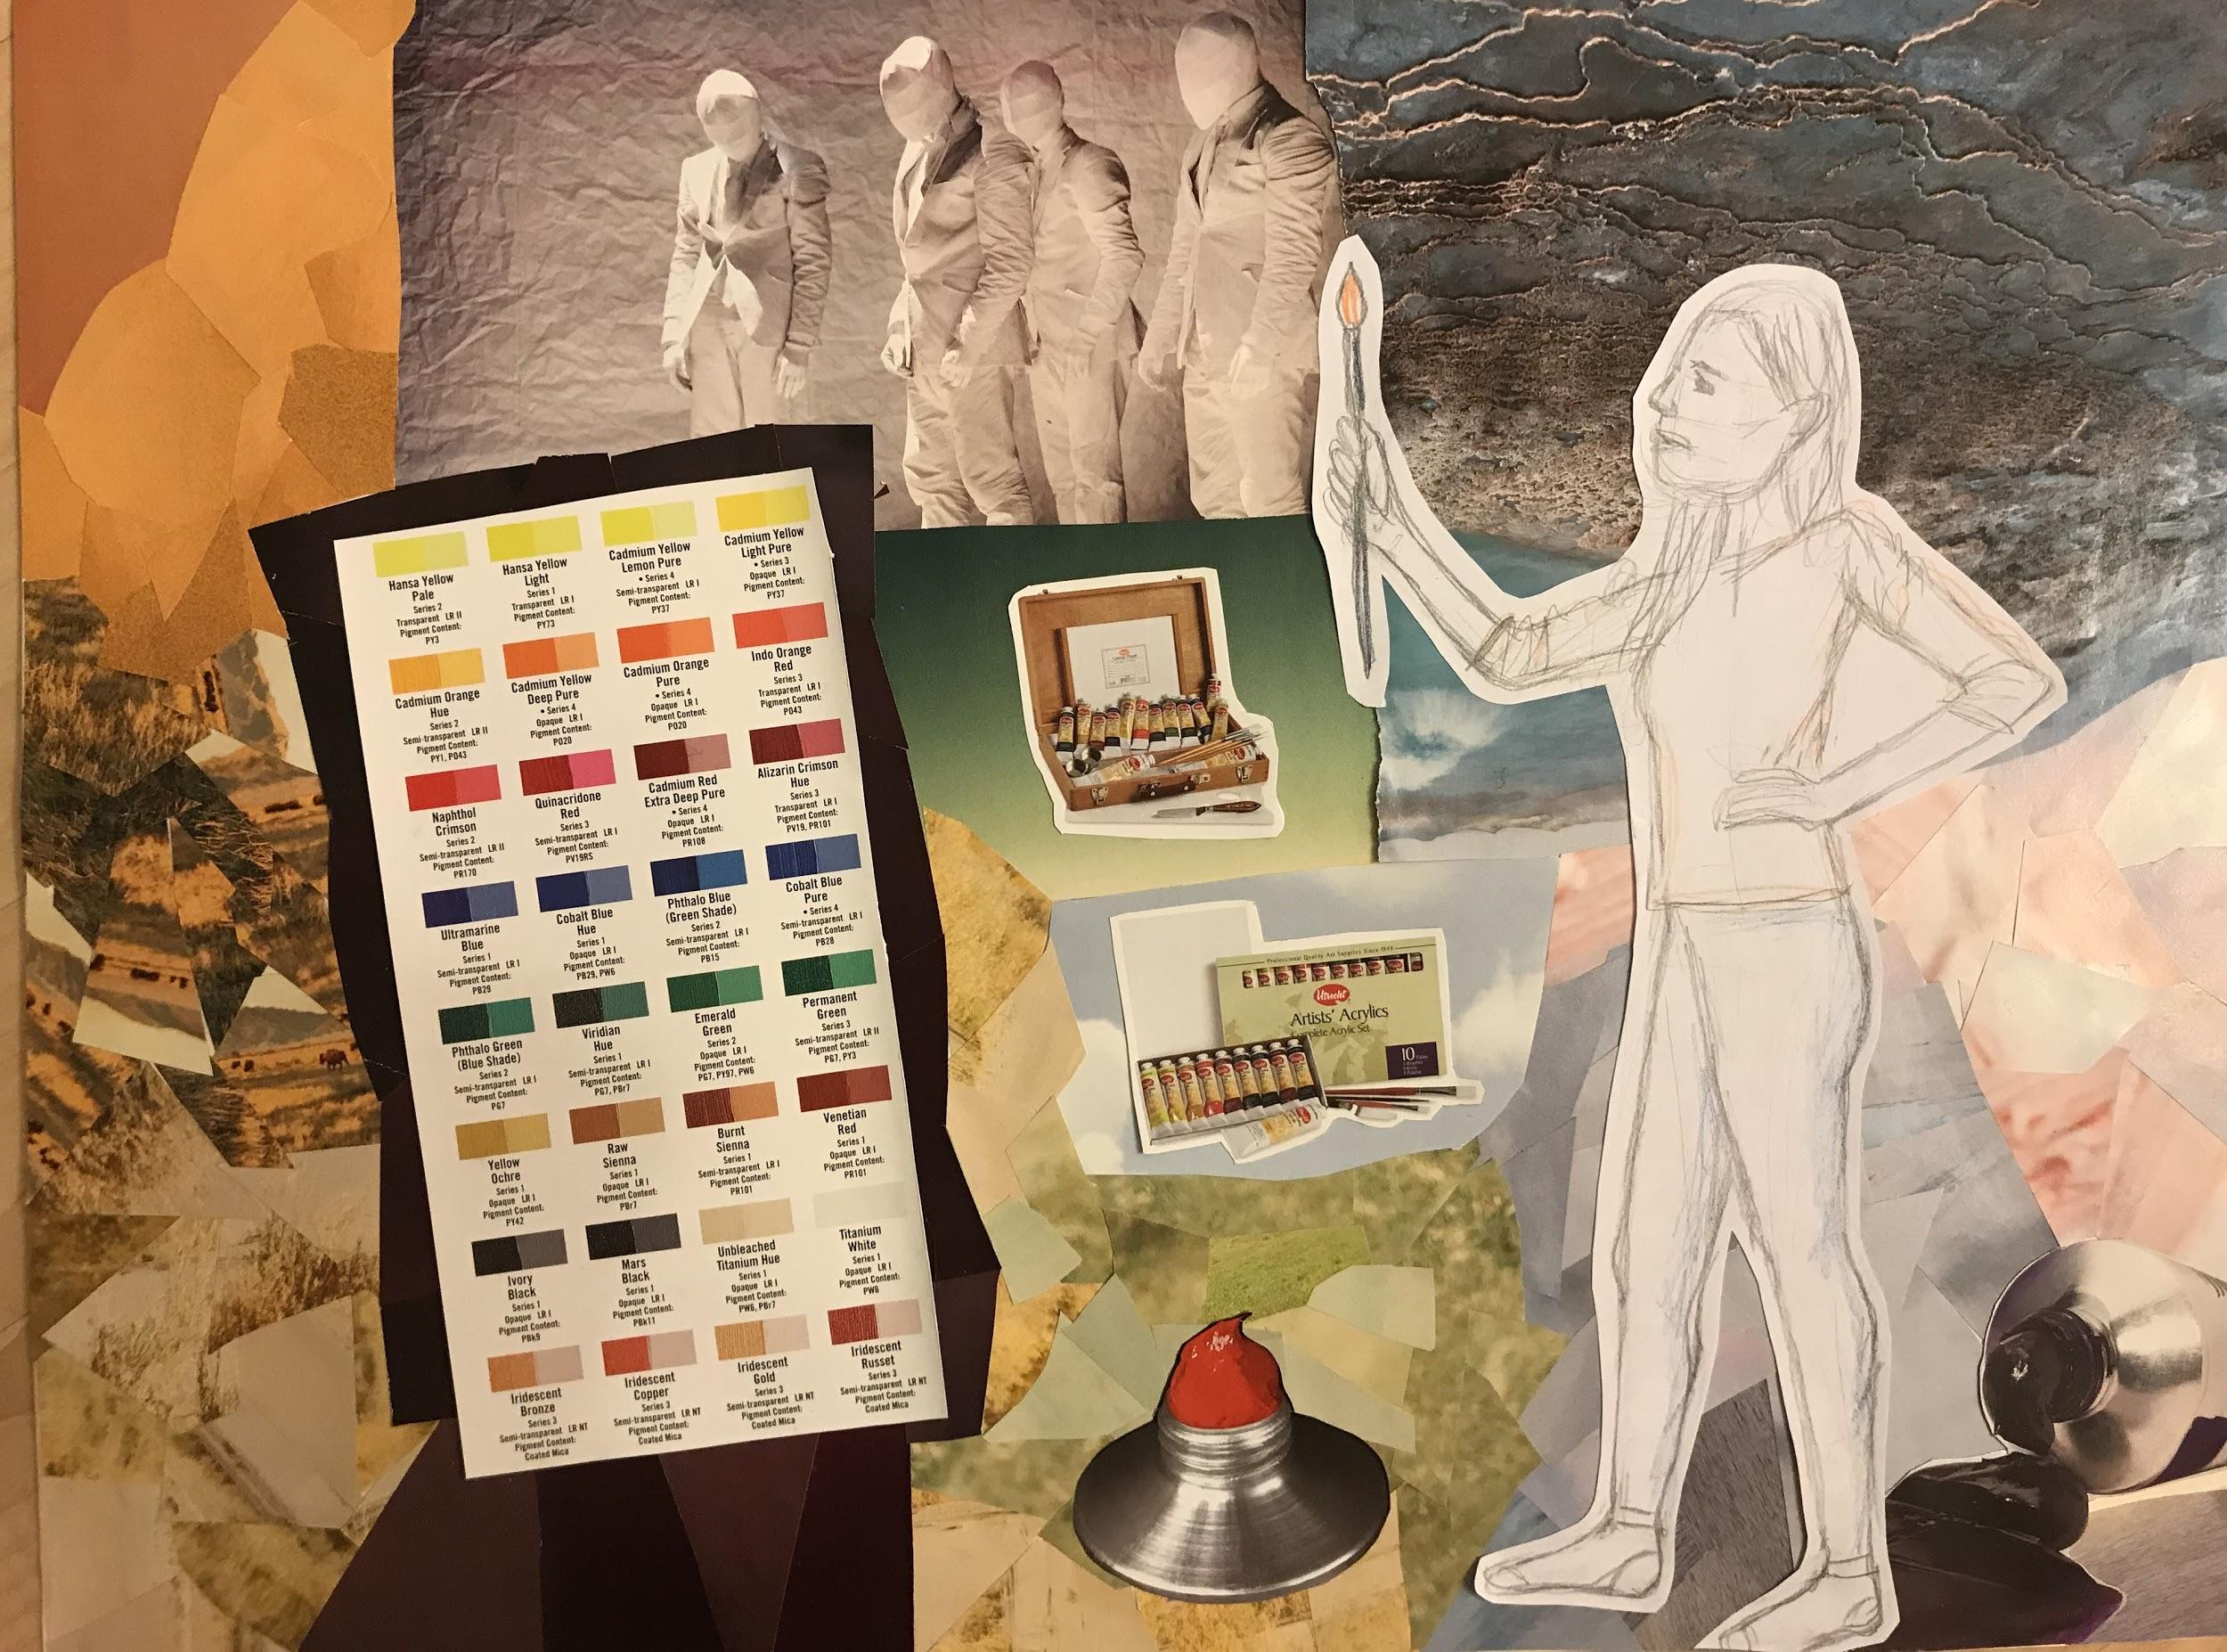

Slide 5
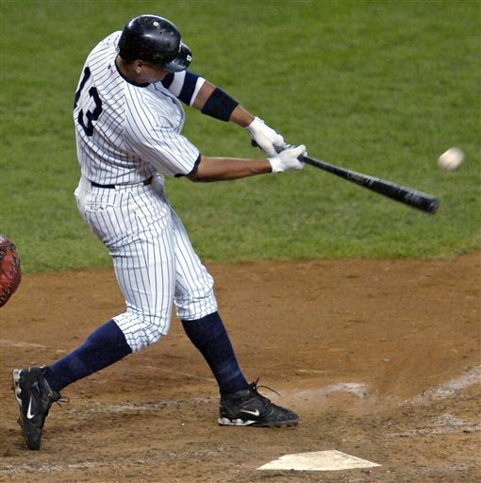
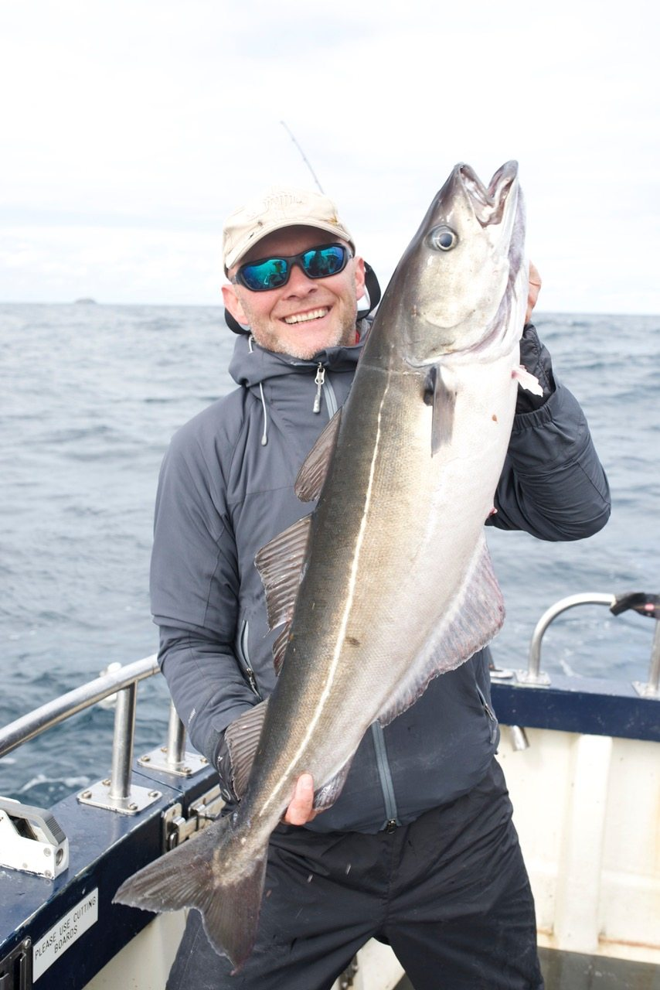
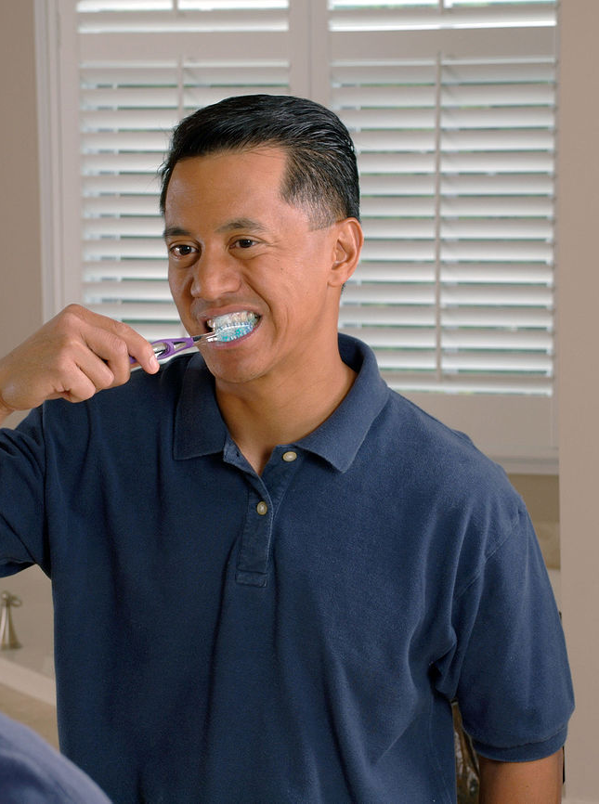
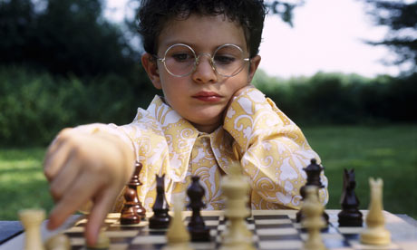
Narrative Collage
Everyday activities
Depict someone having an experience

Slide 6
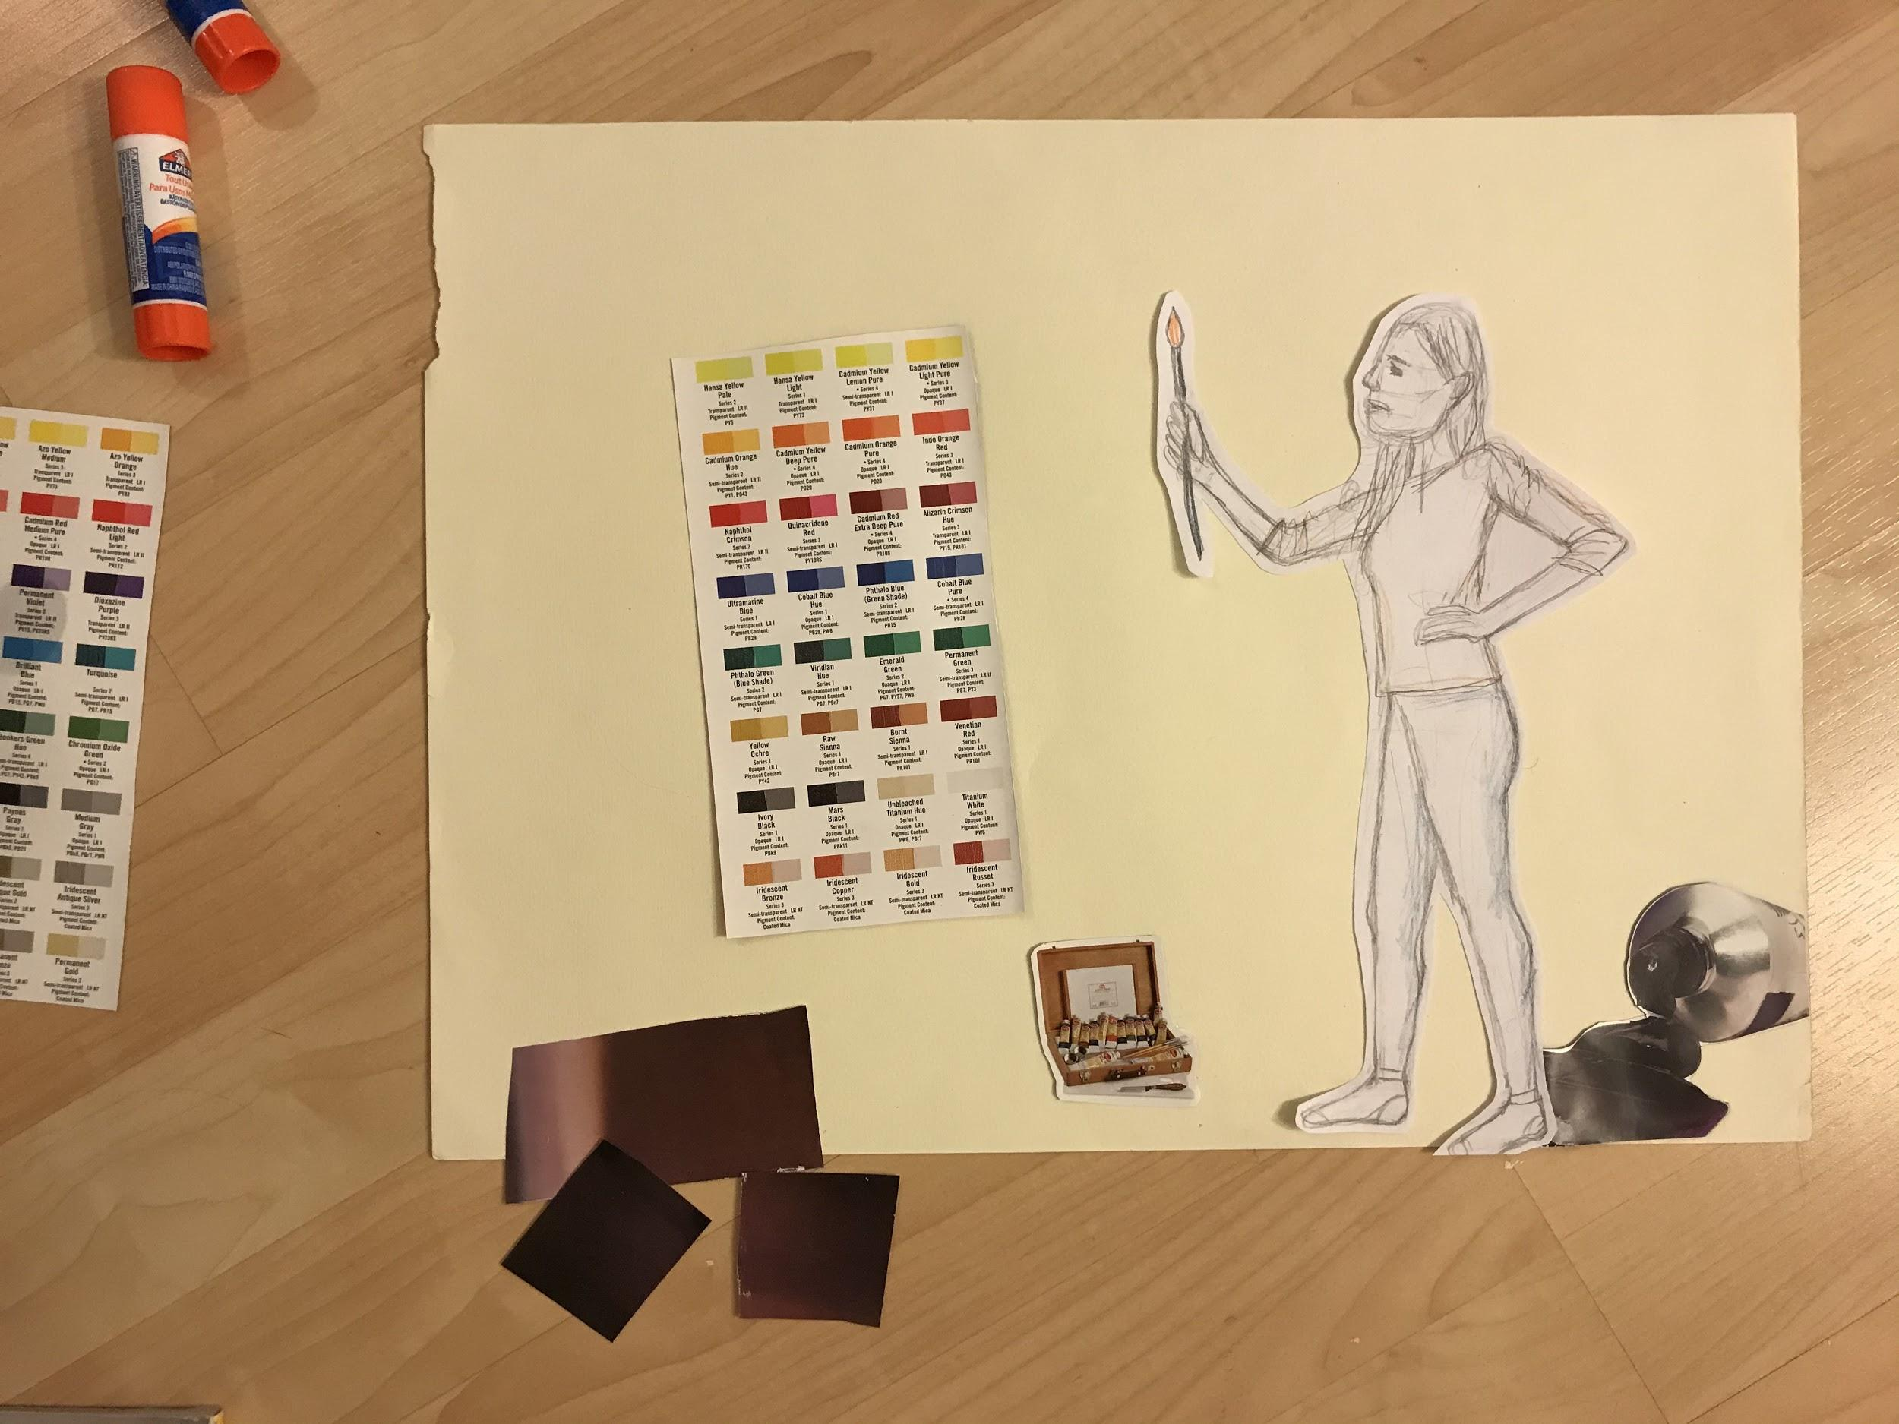
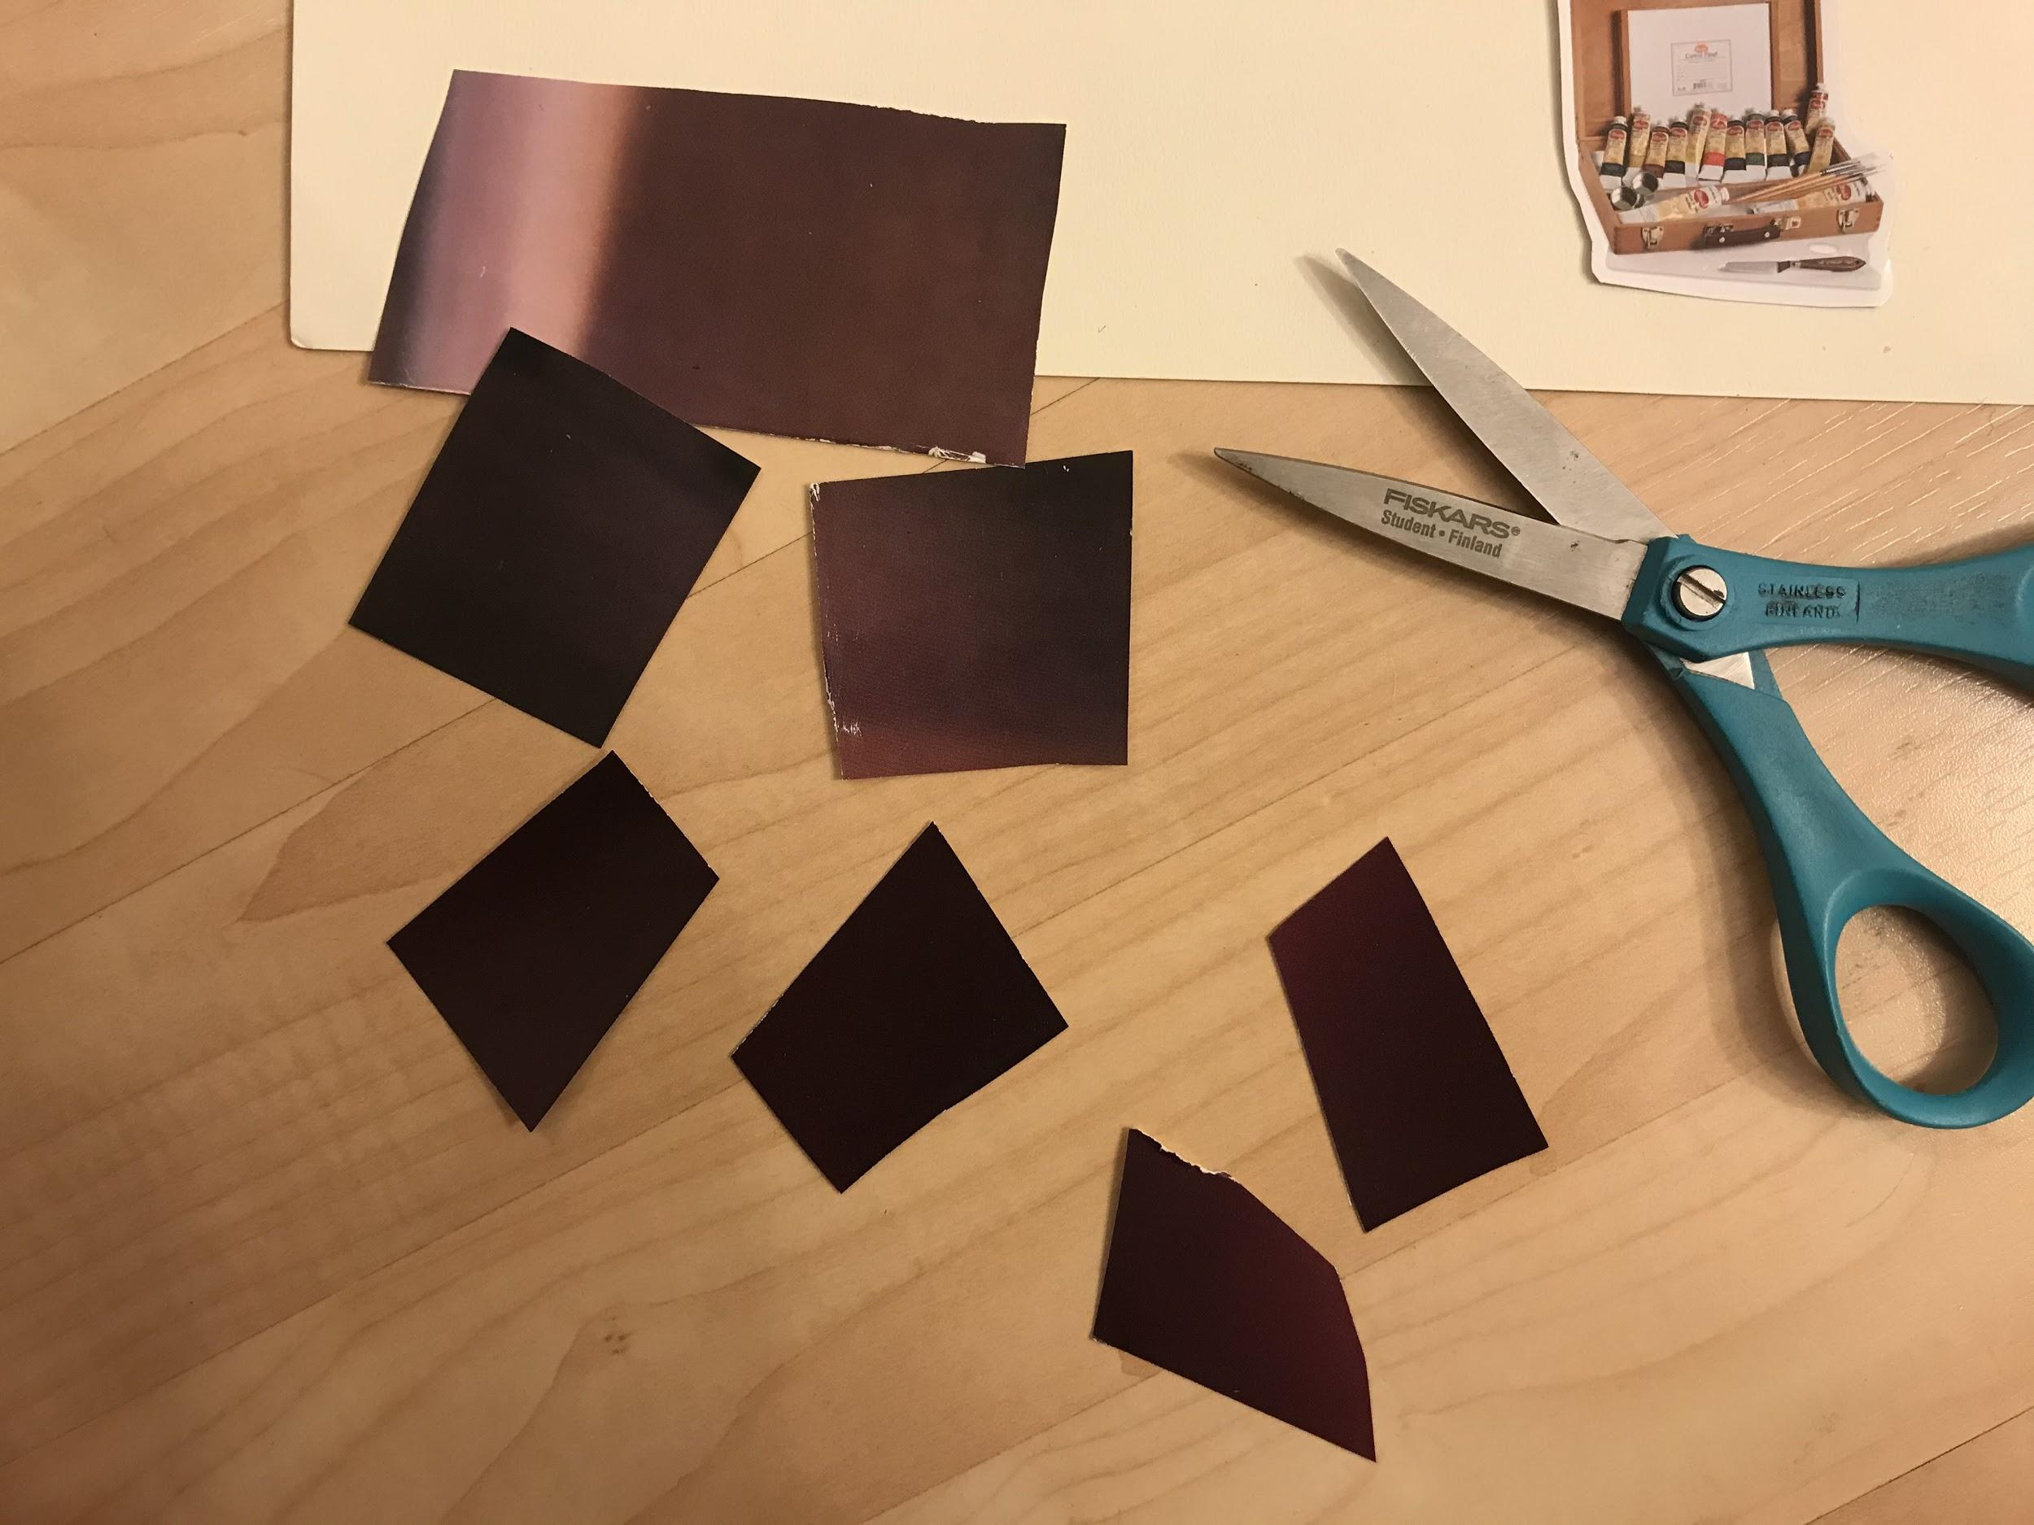
Drawing + Collage
Drawing - Figure in action
Collage - A place (context, surroundings, environment, background)

Slide 7
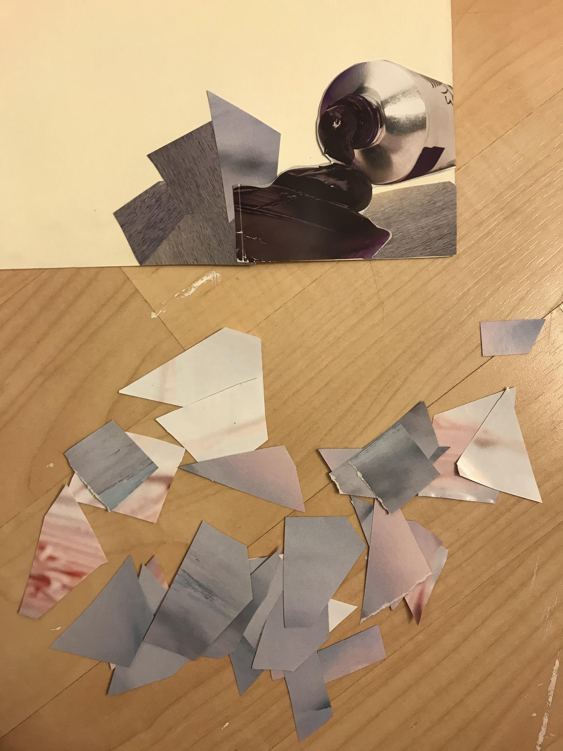
For the next 15 minutes…
Pick a topic
Look through magazines, collect images
Search for a figure reference image
or
Take a figure reference image

Slide 8
For the remainder of the hour....
Work on your pencil figure drawing

