Slide 1
Semiotics
Maya, Sam, & Haley

Slide 2
Apple

Slide 3
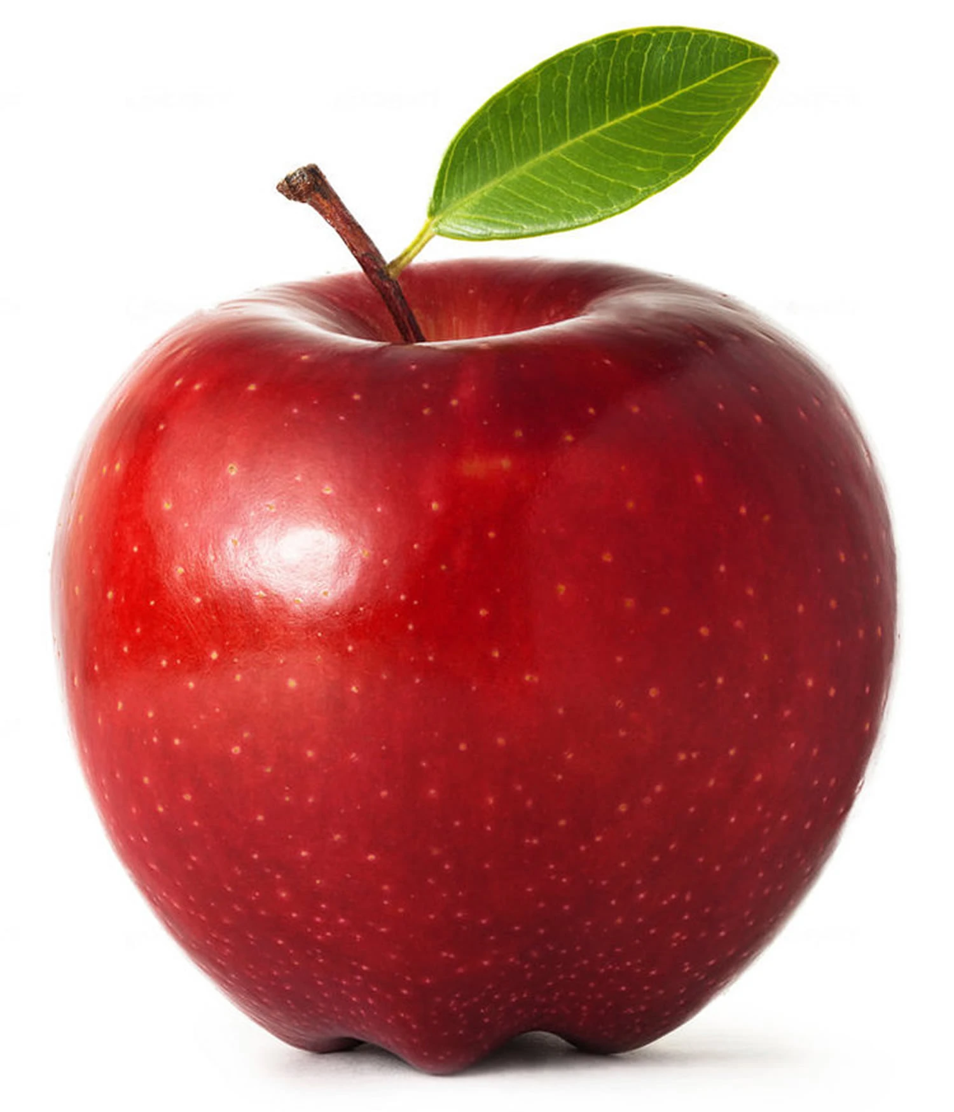

Slide 4


Slide 5


Slide 6


Slide 7
What is semiotics?
The study of signs and symbols and their interpretation, use, or meaning.

Slide 8
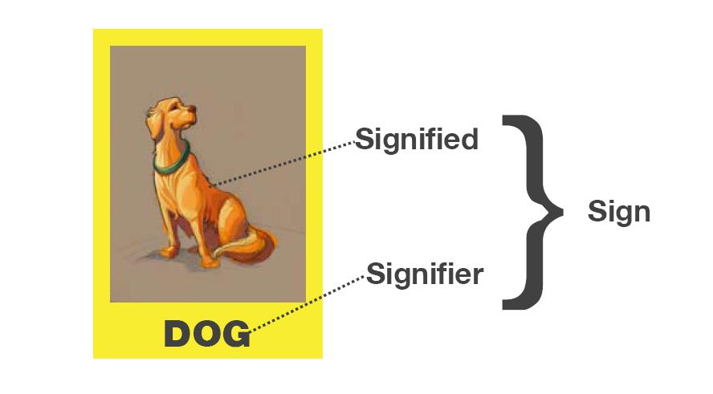
Two Components of a Sign:
The Signified: what it represents - the idea of the thing it refers to
  The signified has 3 components - Denotation, Connotation, and Myth
The Signifier: the physical sign - image, word, or sound
  The signifier has 3 components - Icon, Symbol, and Index

Slide 9
Signified
    Denotation - the literal meaning of a word, in contrast to the feelings or ideas that the word suggests
    Connotation - an idea or feeling that a word invokes in addition to its literal or primary meaning
    Myth - a metaphor, cultural stories and values

Slide 10
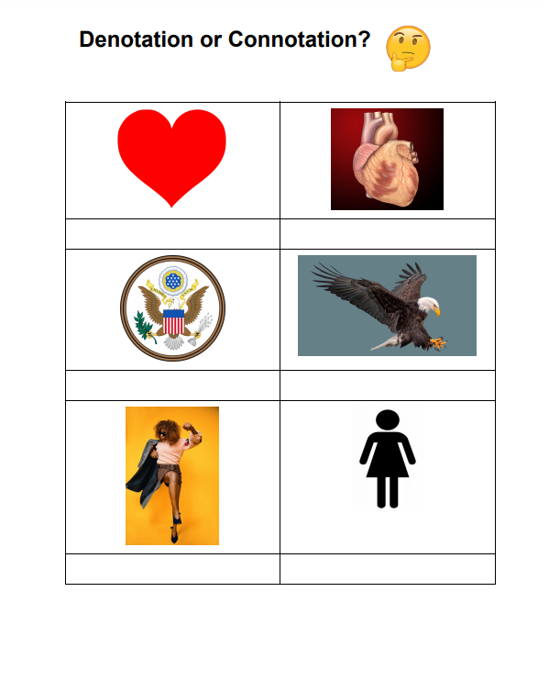
Notes:
Denotation - the literal meaning of a word, in contrast to the feelings or ideas that the word suggests
Connotation - an idea or feeling that a word invokes in addition to its literal or primary meaning

Slide 11


Signifier: Icon
The sign resembles the object literally.
Physically similar
  Ex. Drawing of a pencil
  Ex. Cat figurine

Slide 12

Signifier: Symbol
Is not a literal representation of the object.
Learned
Arbitrary (random) or conventional
  Ex: Play and Pause button (there is no actual association but we know that this means play or pause)
Notes:
Hand out worksheet

Slide 13

Signifier: Index
There is a direct link between the sign and the object. The sign implies the object.
Can be inferred or observed
Not arbitrary (random)
  Ex. cat foot prints → cat
  Ex. smoke → fire

Slide 14



Notes:
Icon symbol index

Slide 15

Putting it all together

Slide 16

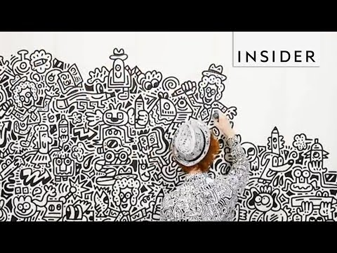
Artist: Sam Cox
Notes:
haley

Slide 17
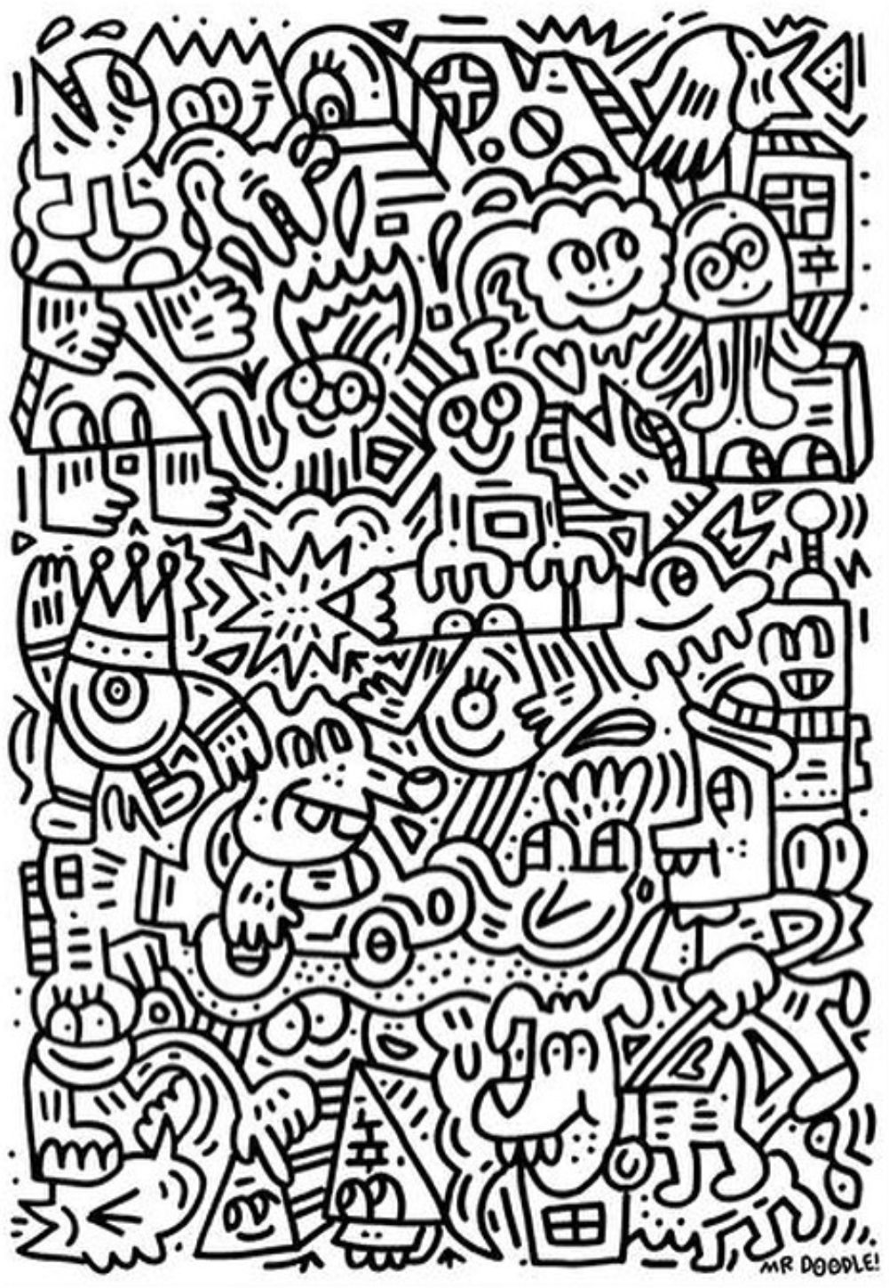
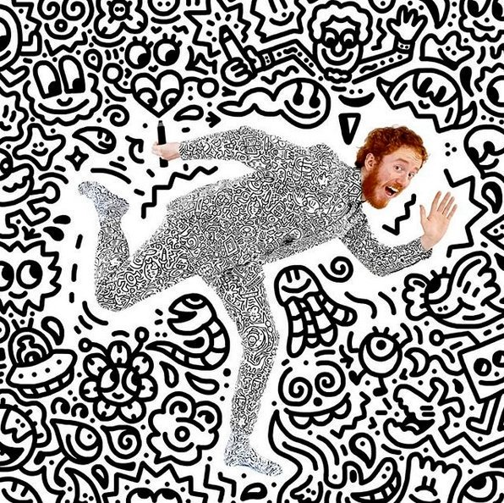
Mr. Doodle
Notes:
haley

Slide 18
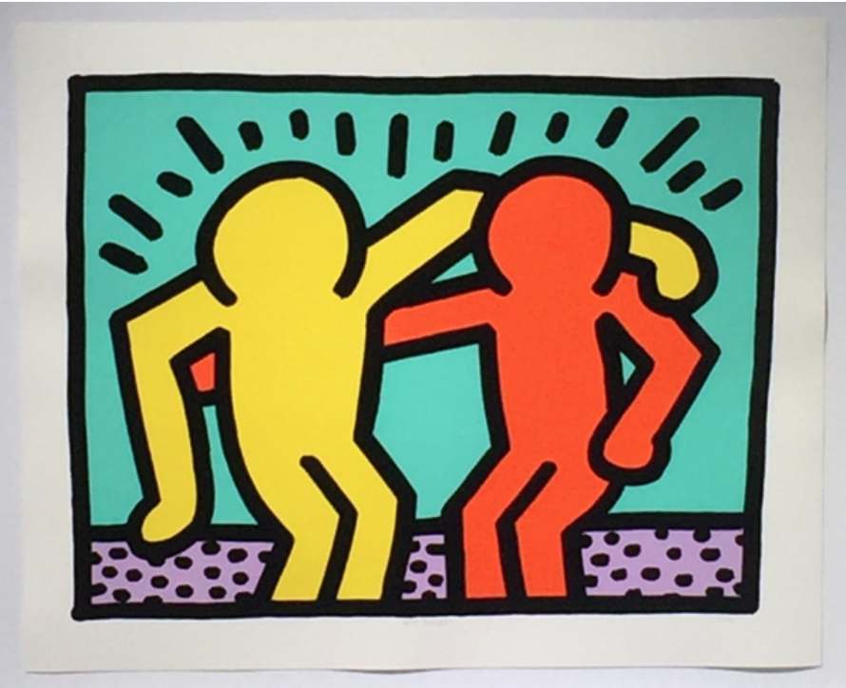
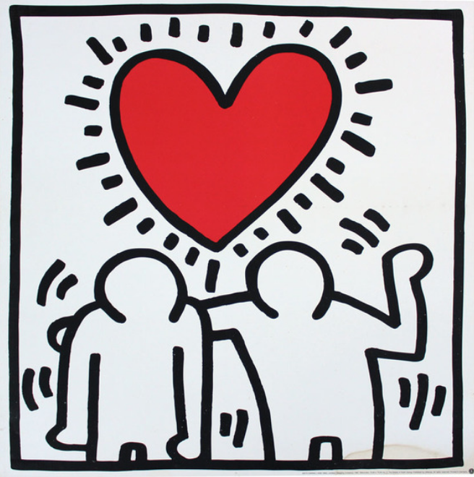
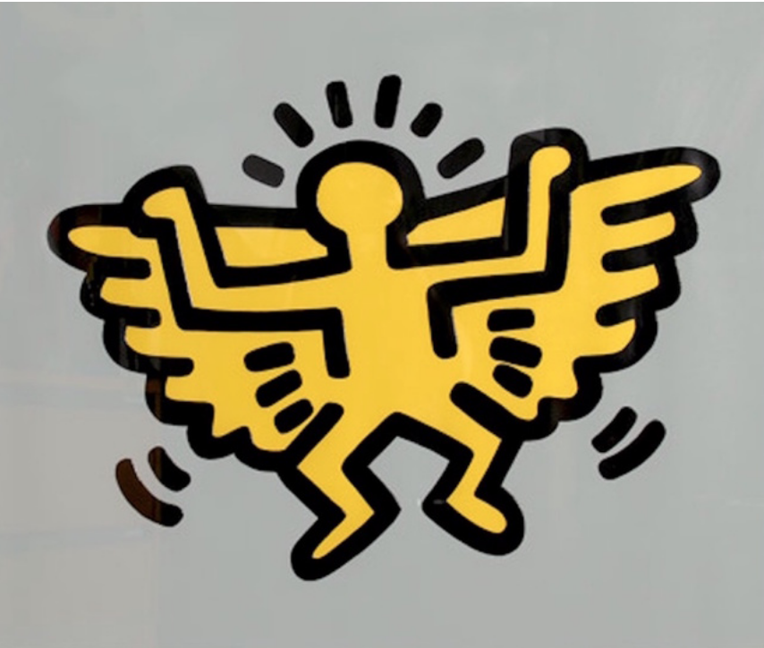
Keith Haring
Best Buddies, 1990
Screenprint
26 × 32 in
66 × 81.3 cm
Edition of 200
Wedding Invitation, ca. 1993
Offset lithograph mounted on wood
23 1/2 × 23 1/2 in
59.7 × 59.7 cm
Angel from Icons, 1990
Screenprint with Embossing
21 × 25 in
53.3 × 63.5 cm
Edition of 250
Notes:
haley

Slide 19
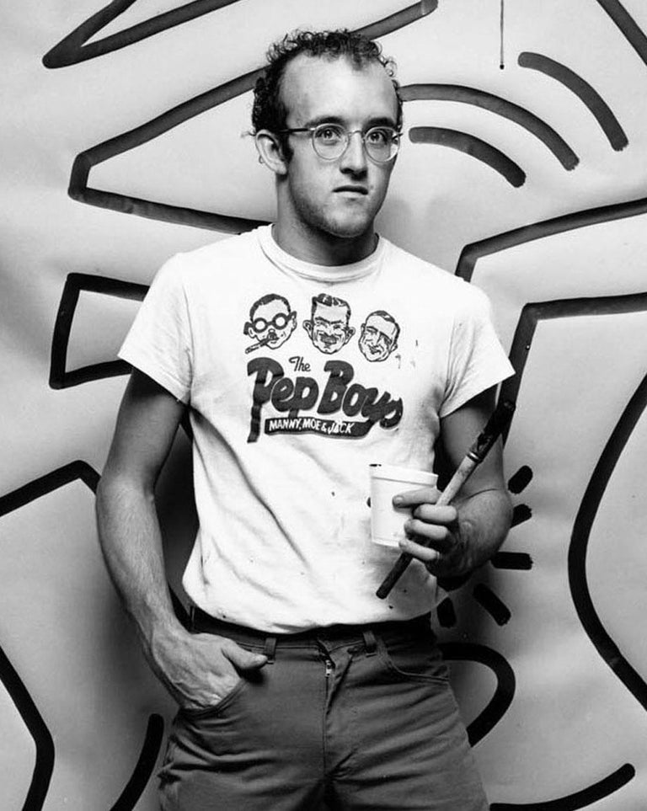
Keith Haring: about
Grew up in Pennsylvania and loved drawing
Late 1970s - art school in Pittsburg - Ivy School of Professional Art
After a year, moved to NYC - School of Visual Arts
Found an art community (music, performance, graffiti)
Created graffiti work on the subway
Gained popularity through the 80s
Exhibited work in galleries
Notes:
haley

Slide 20
Keith Haring: about cont.
Work has a childlike and youthful vibe
Graphic, colorful pop art
Social activism - LBGTQ and AIDS awareness
Love, community, friendship, vibrance, innocence, peace, optimis, equality, humanity
Notes:
haley

Slide 21

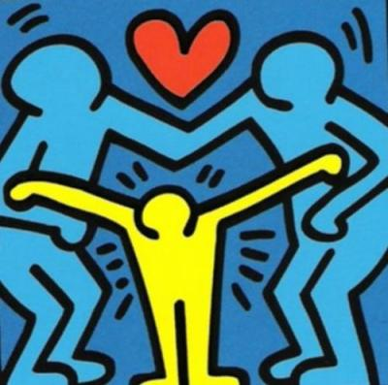

Slide 22
Today’s Plan:
Step 1: Have a table buddy take 3-5 photos of you expressing an emotion using your whole body
Step 2: Use these photos as reference to sketch 3 thumbnails
Step 3: Select one of these sketches to create on a larger scale
Step 4: Create your figure and cut out with scissors
Step 5: Paint thoughtfully
Step 6: Collage together for classroom mural
Notes:
Sam interact with mural

Slide 23
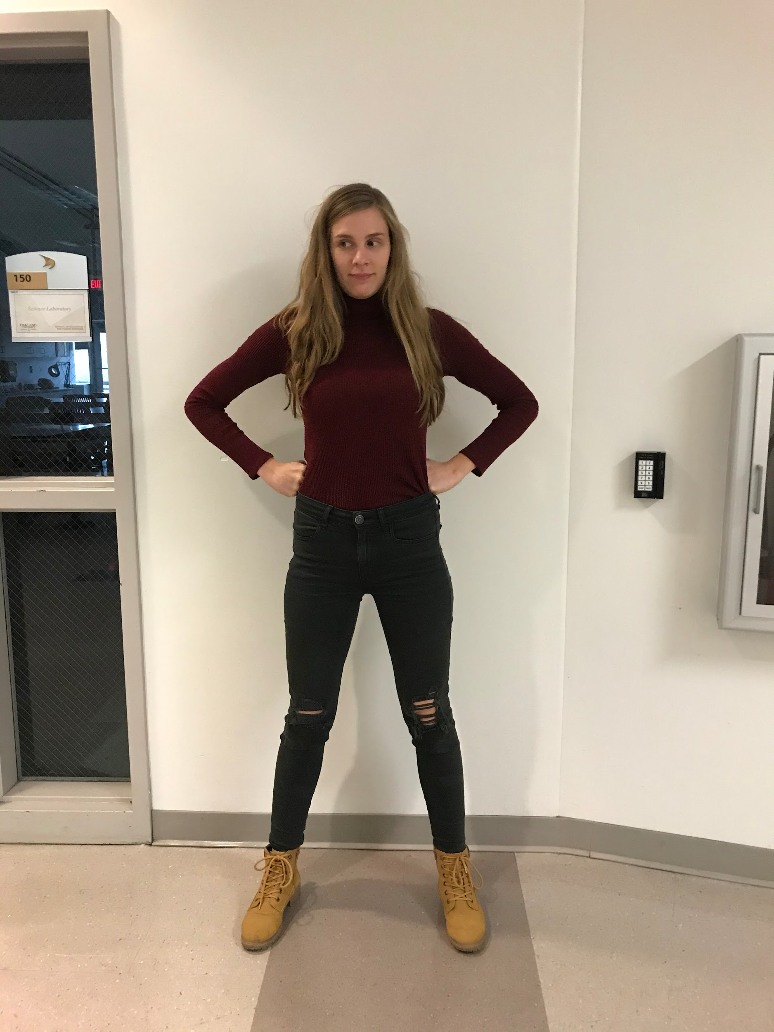
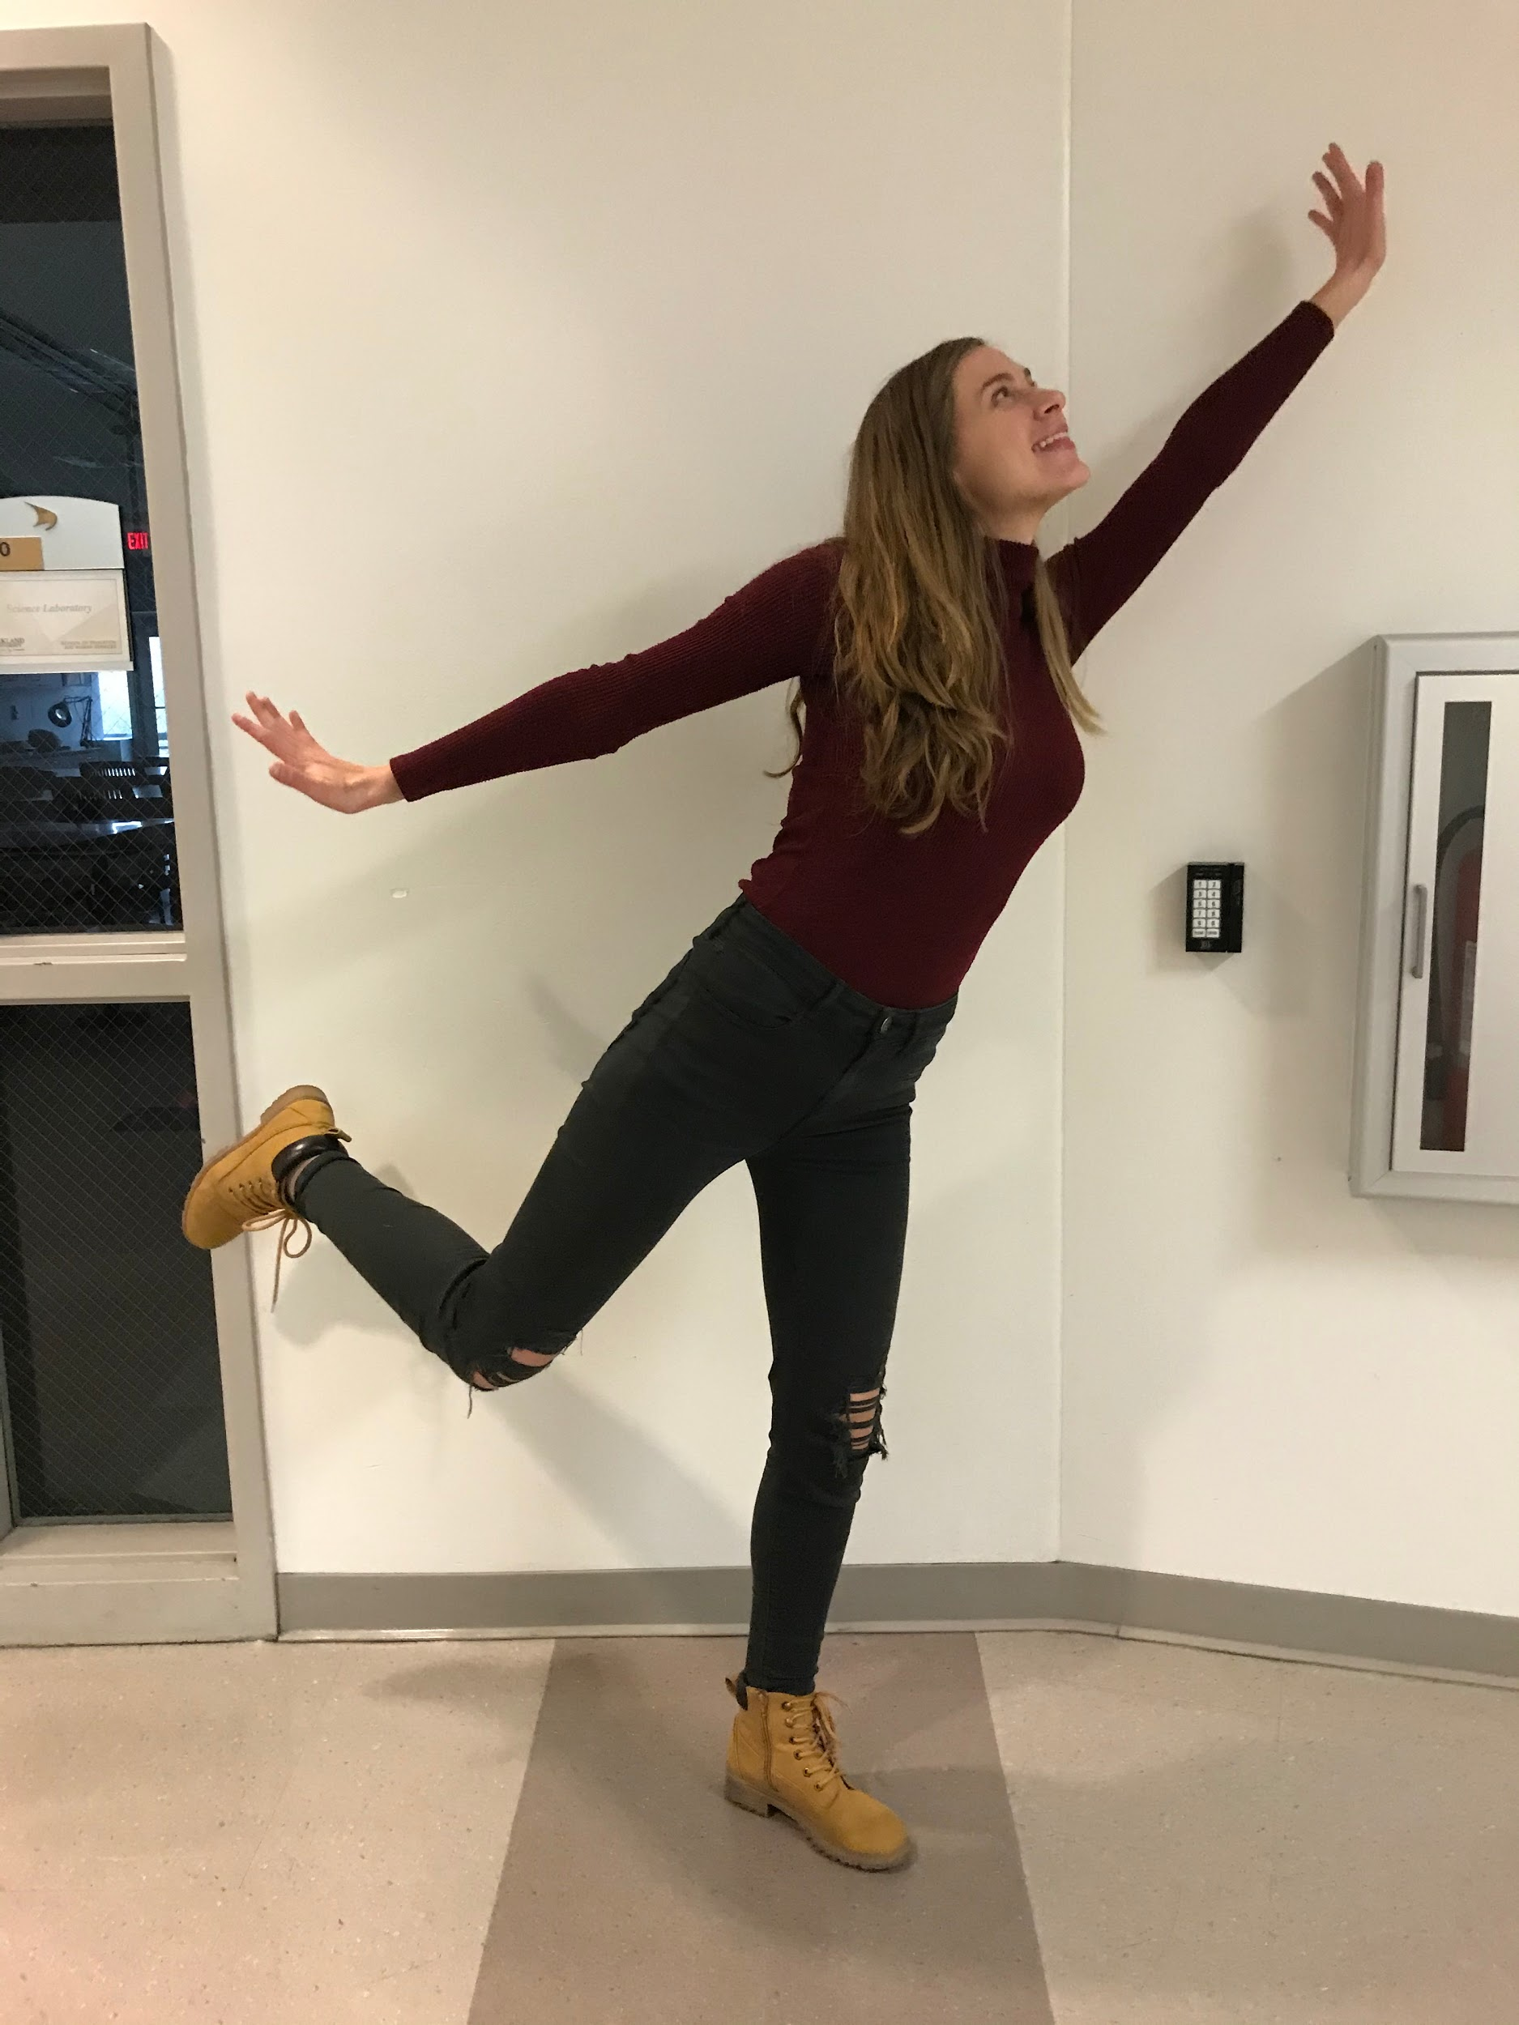
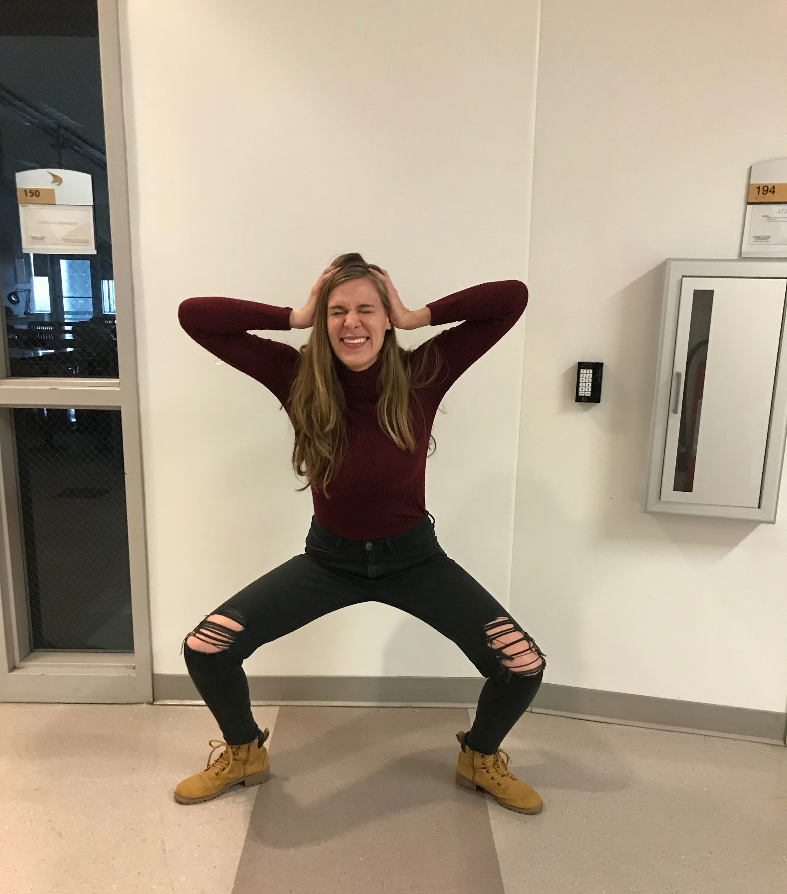
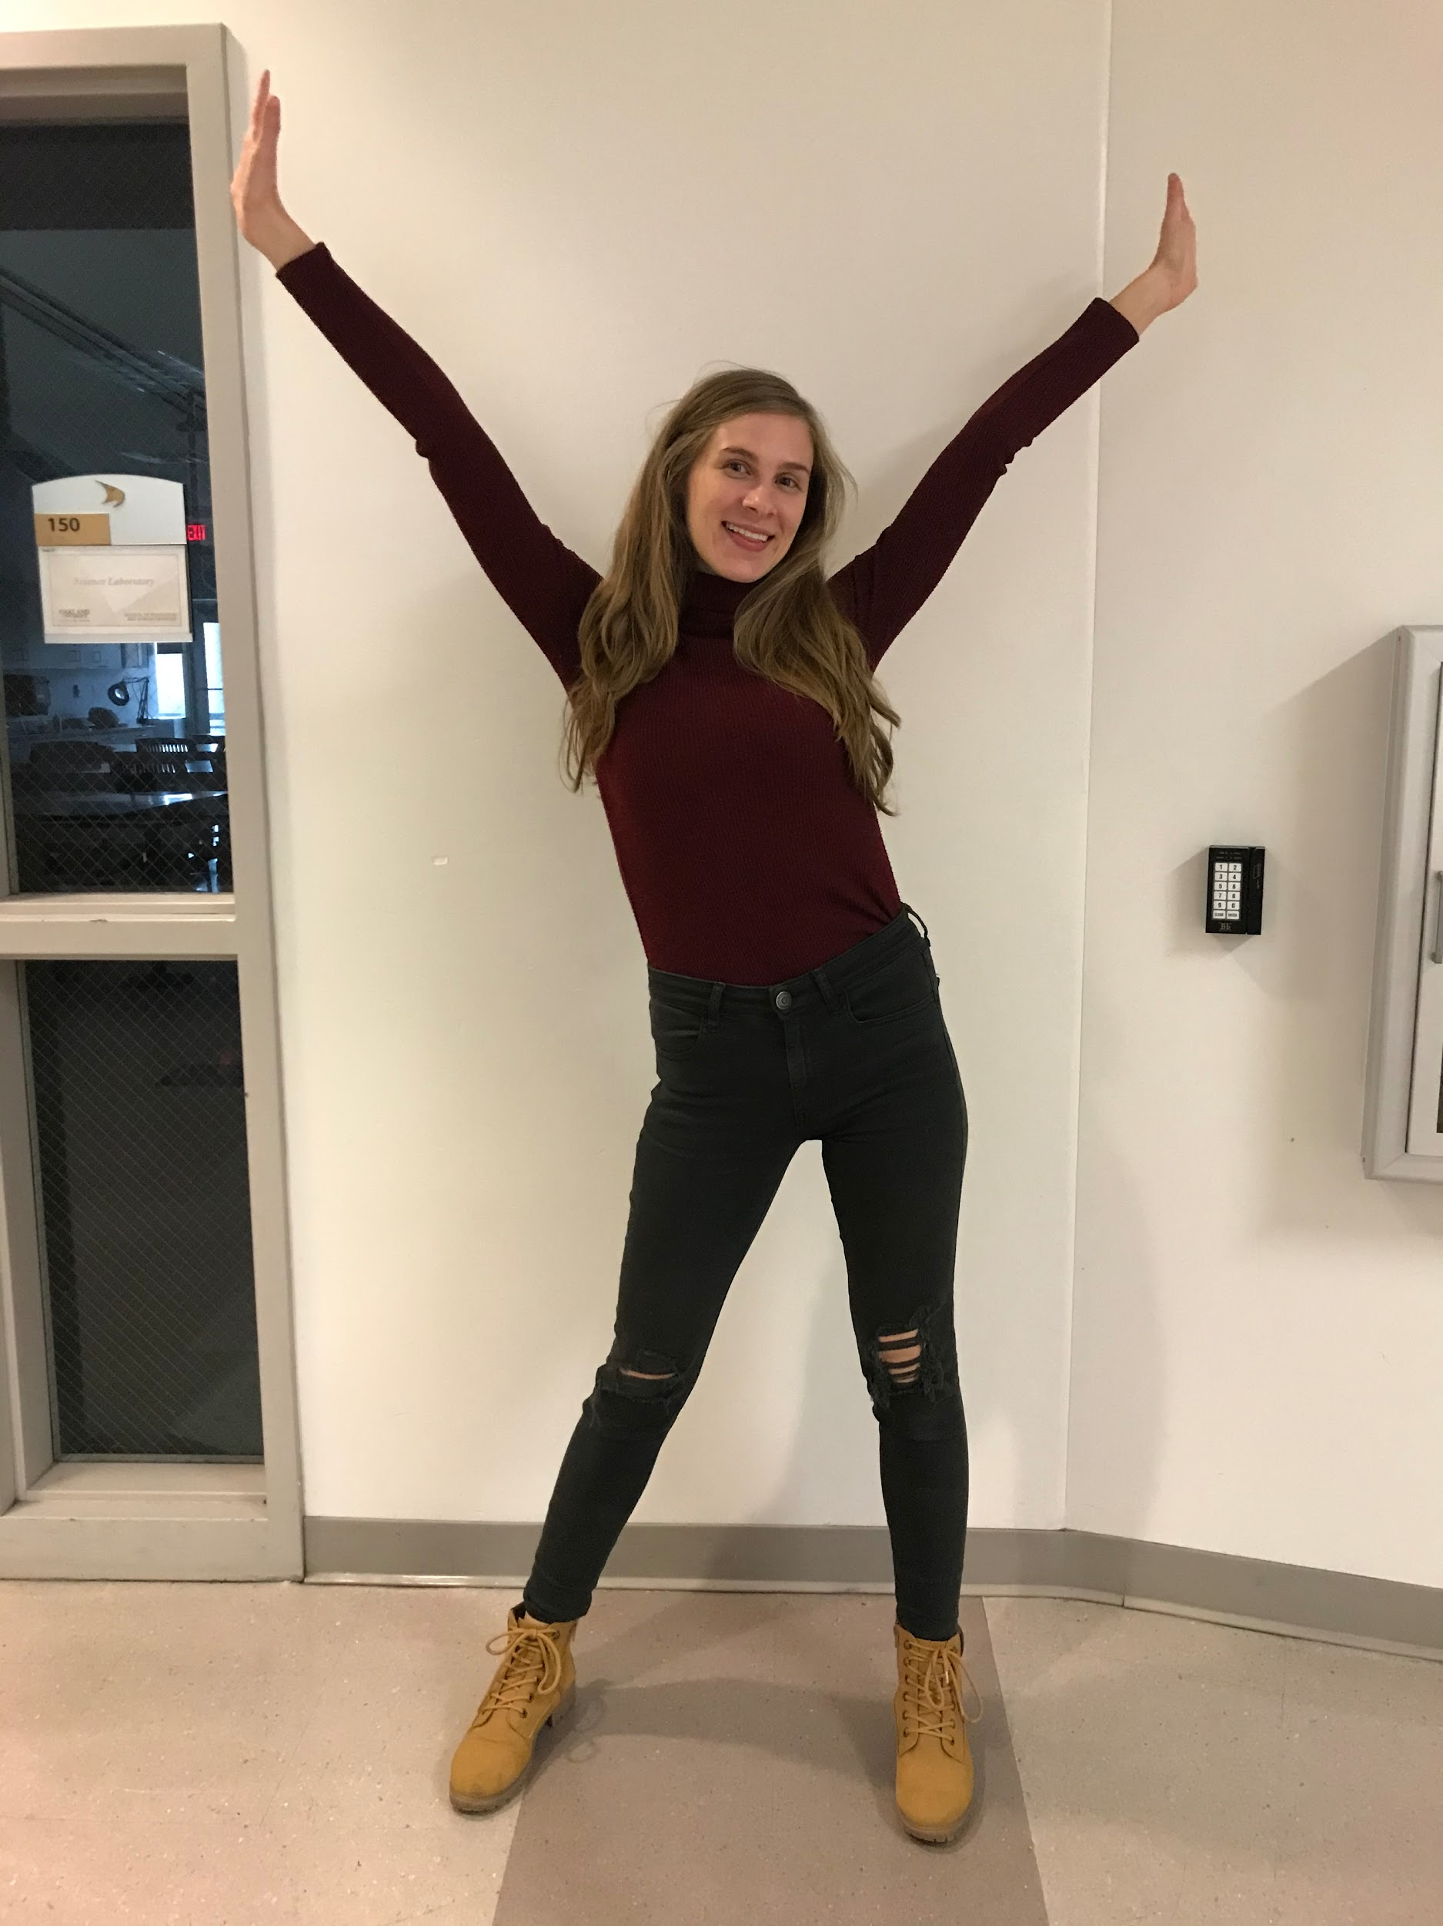
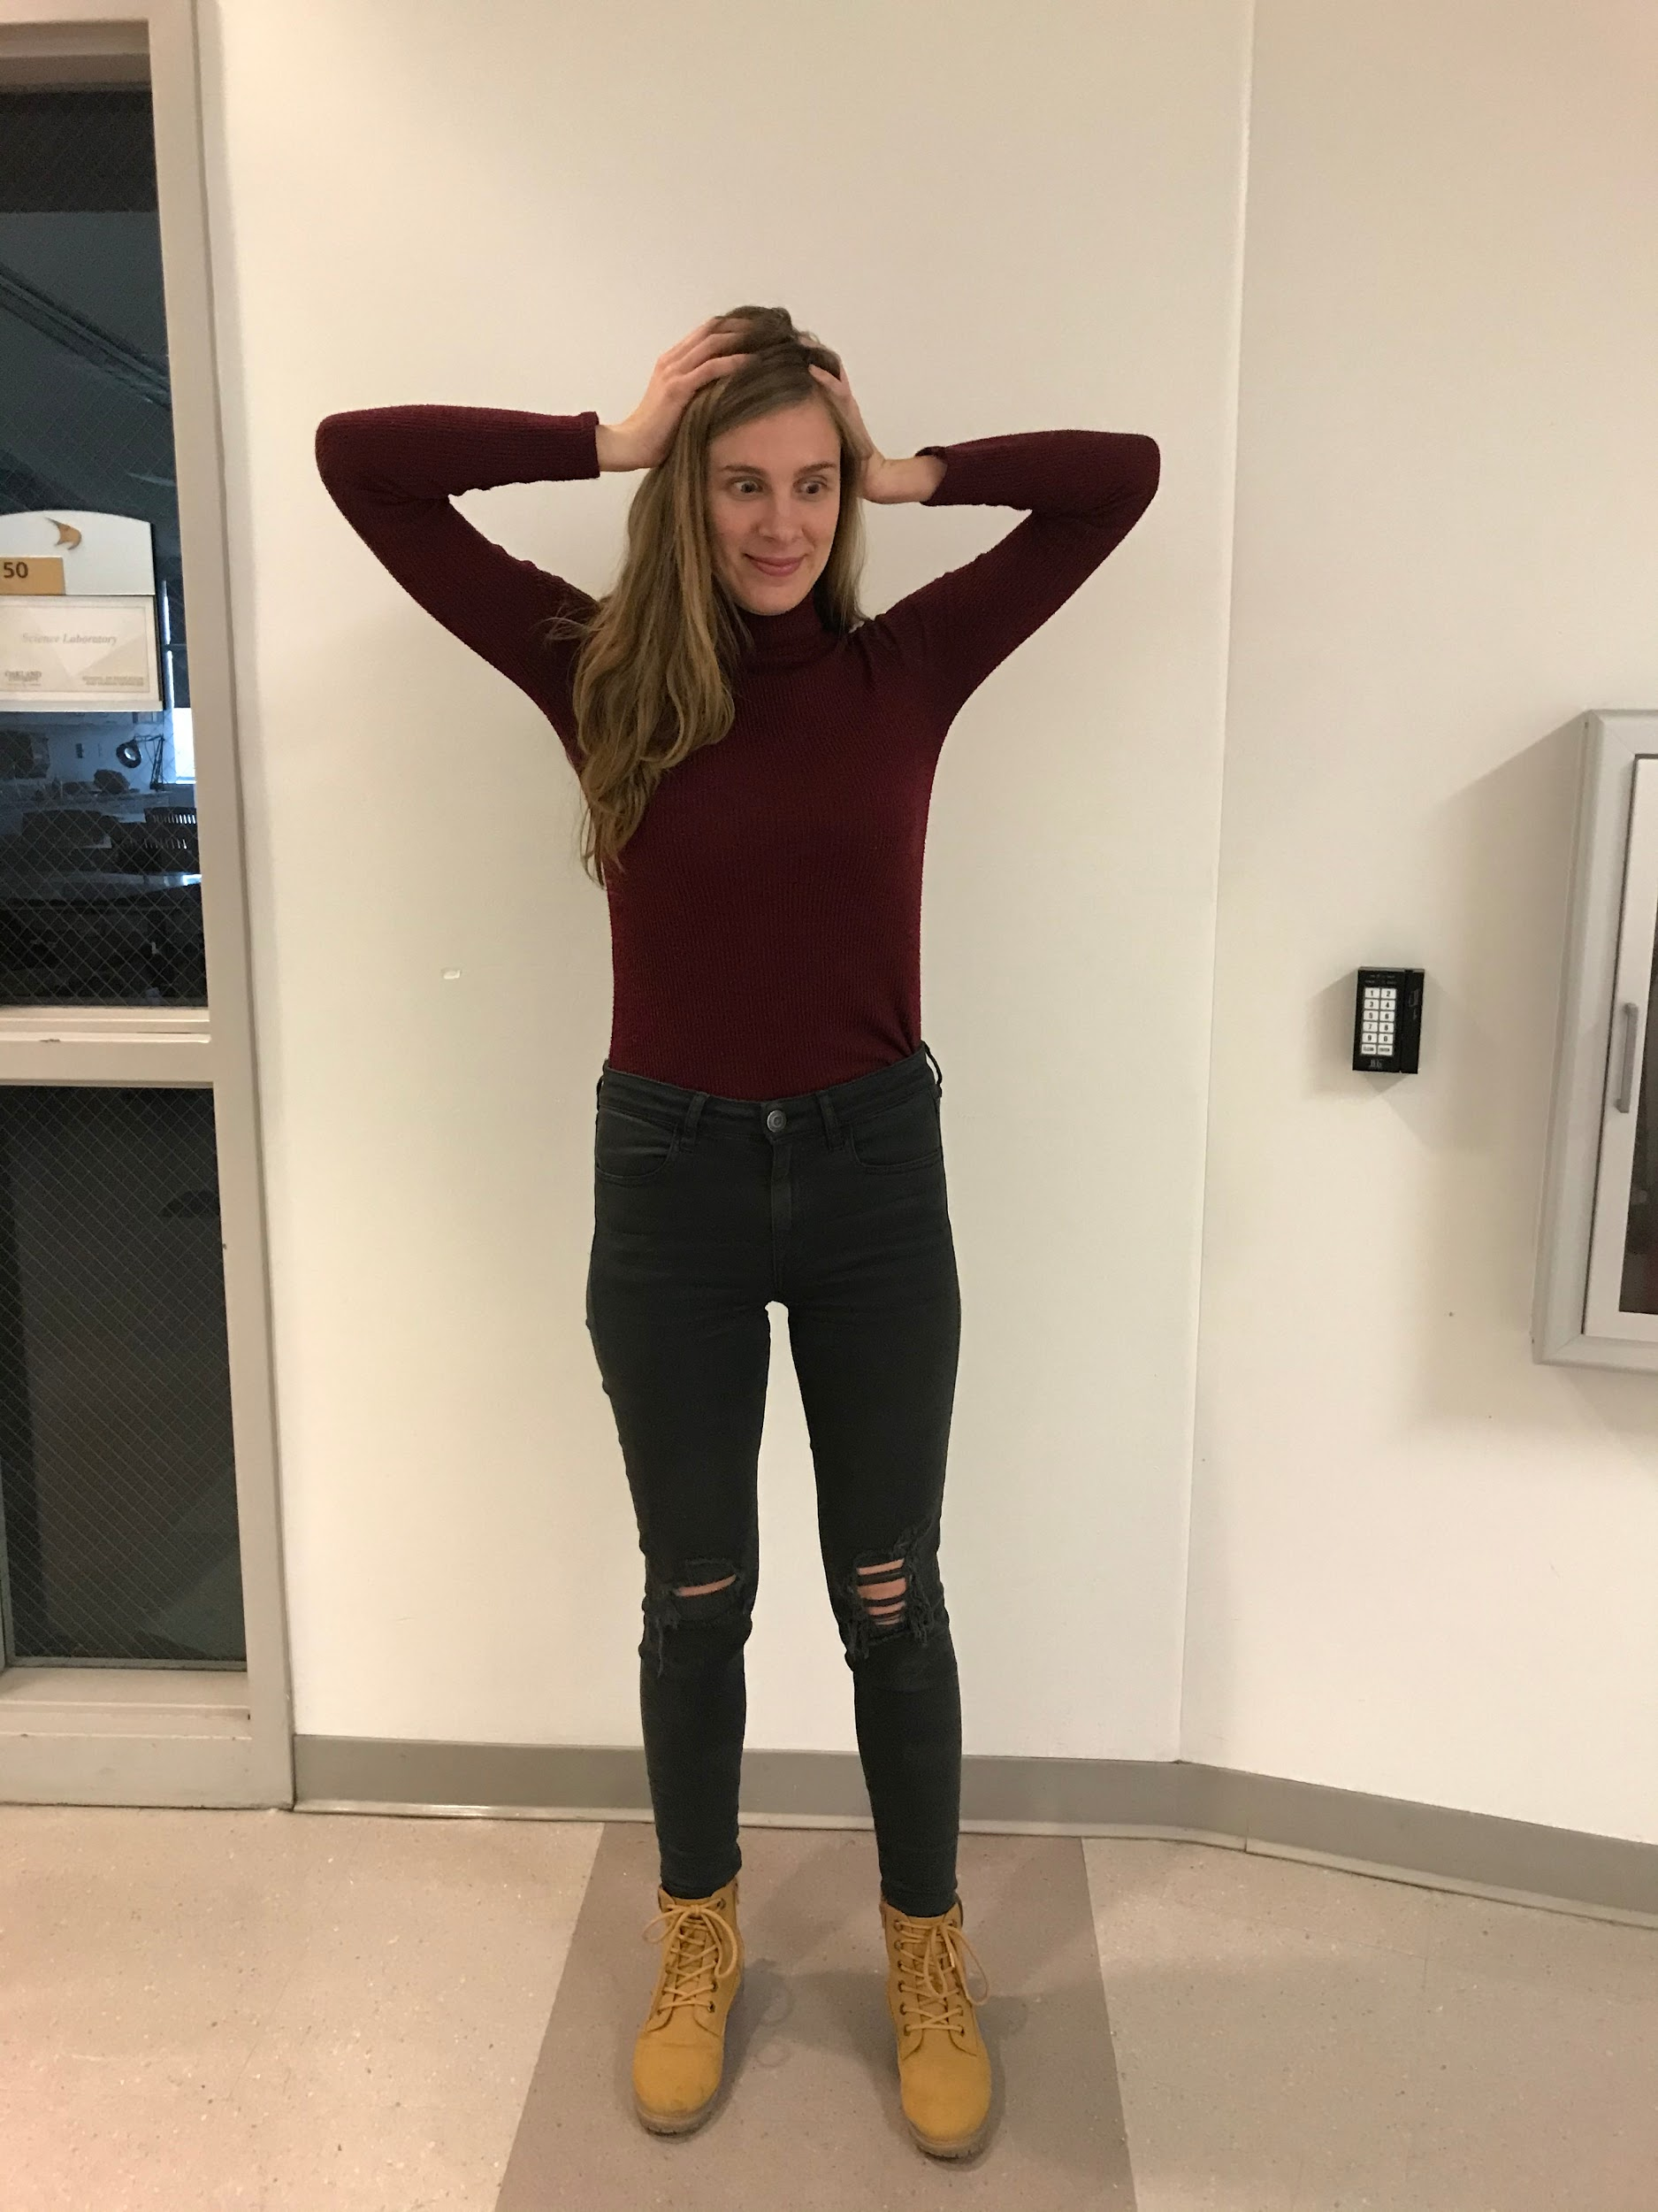
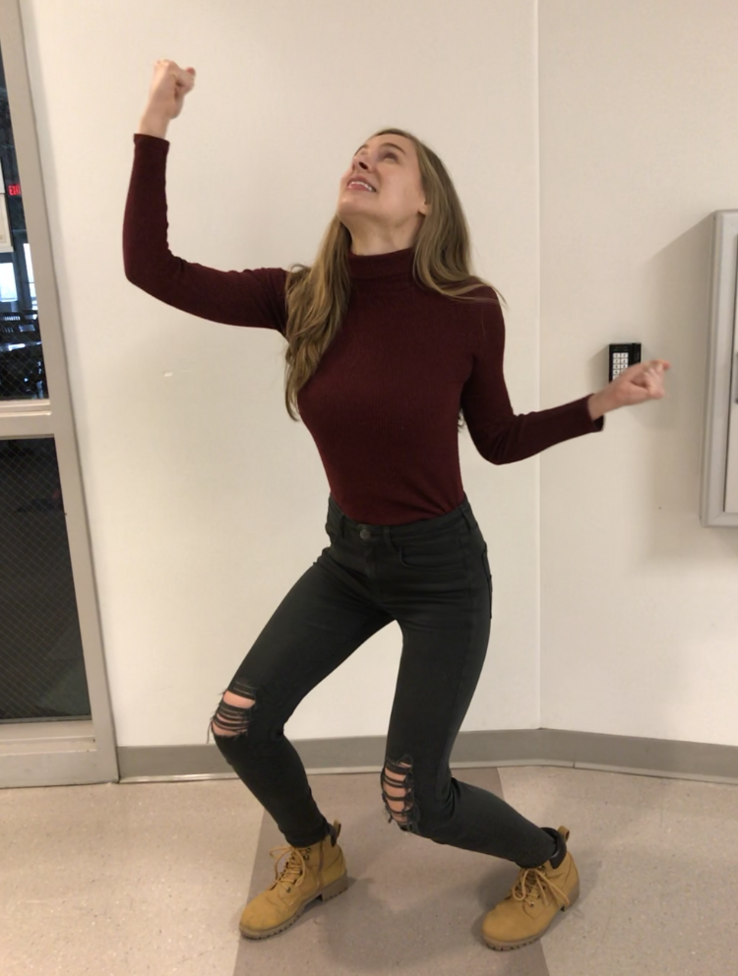

Example

Slide 24
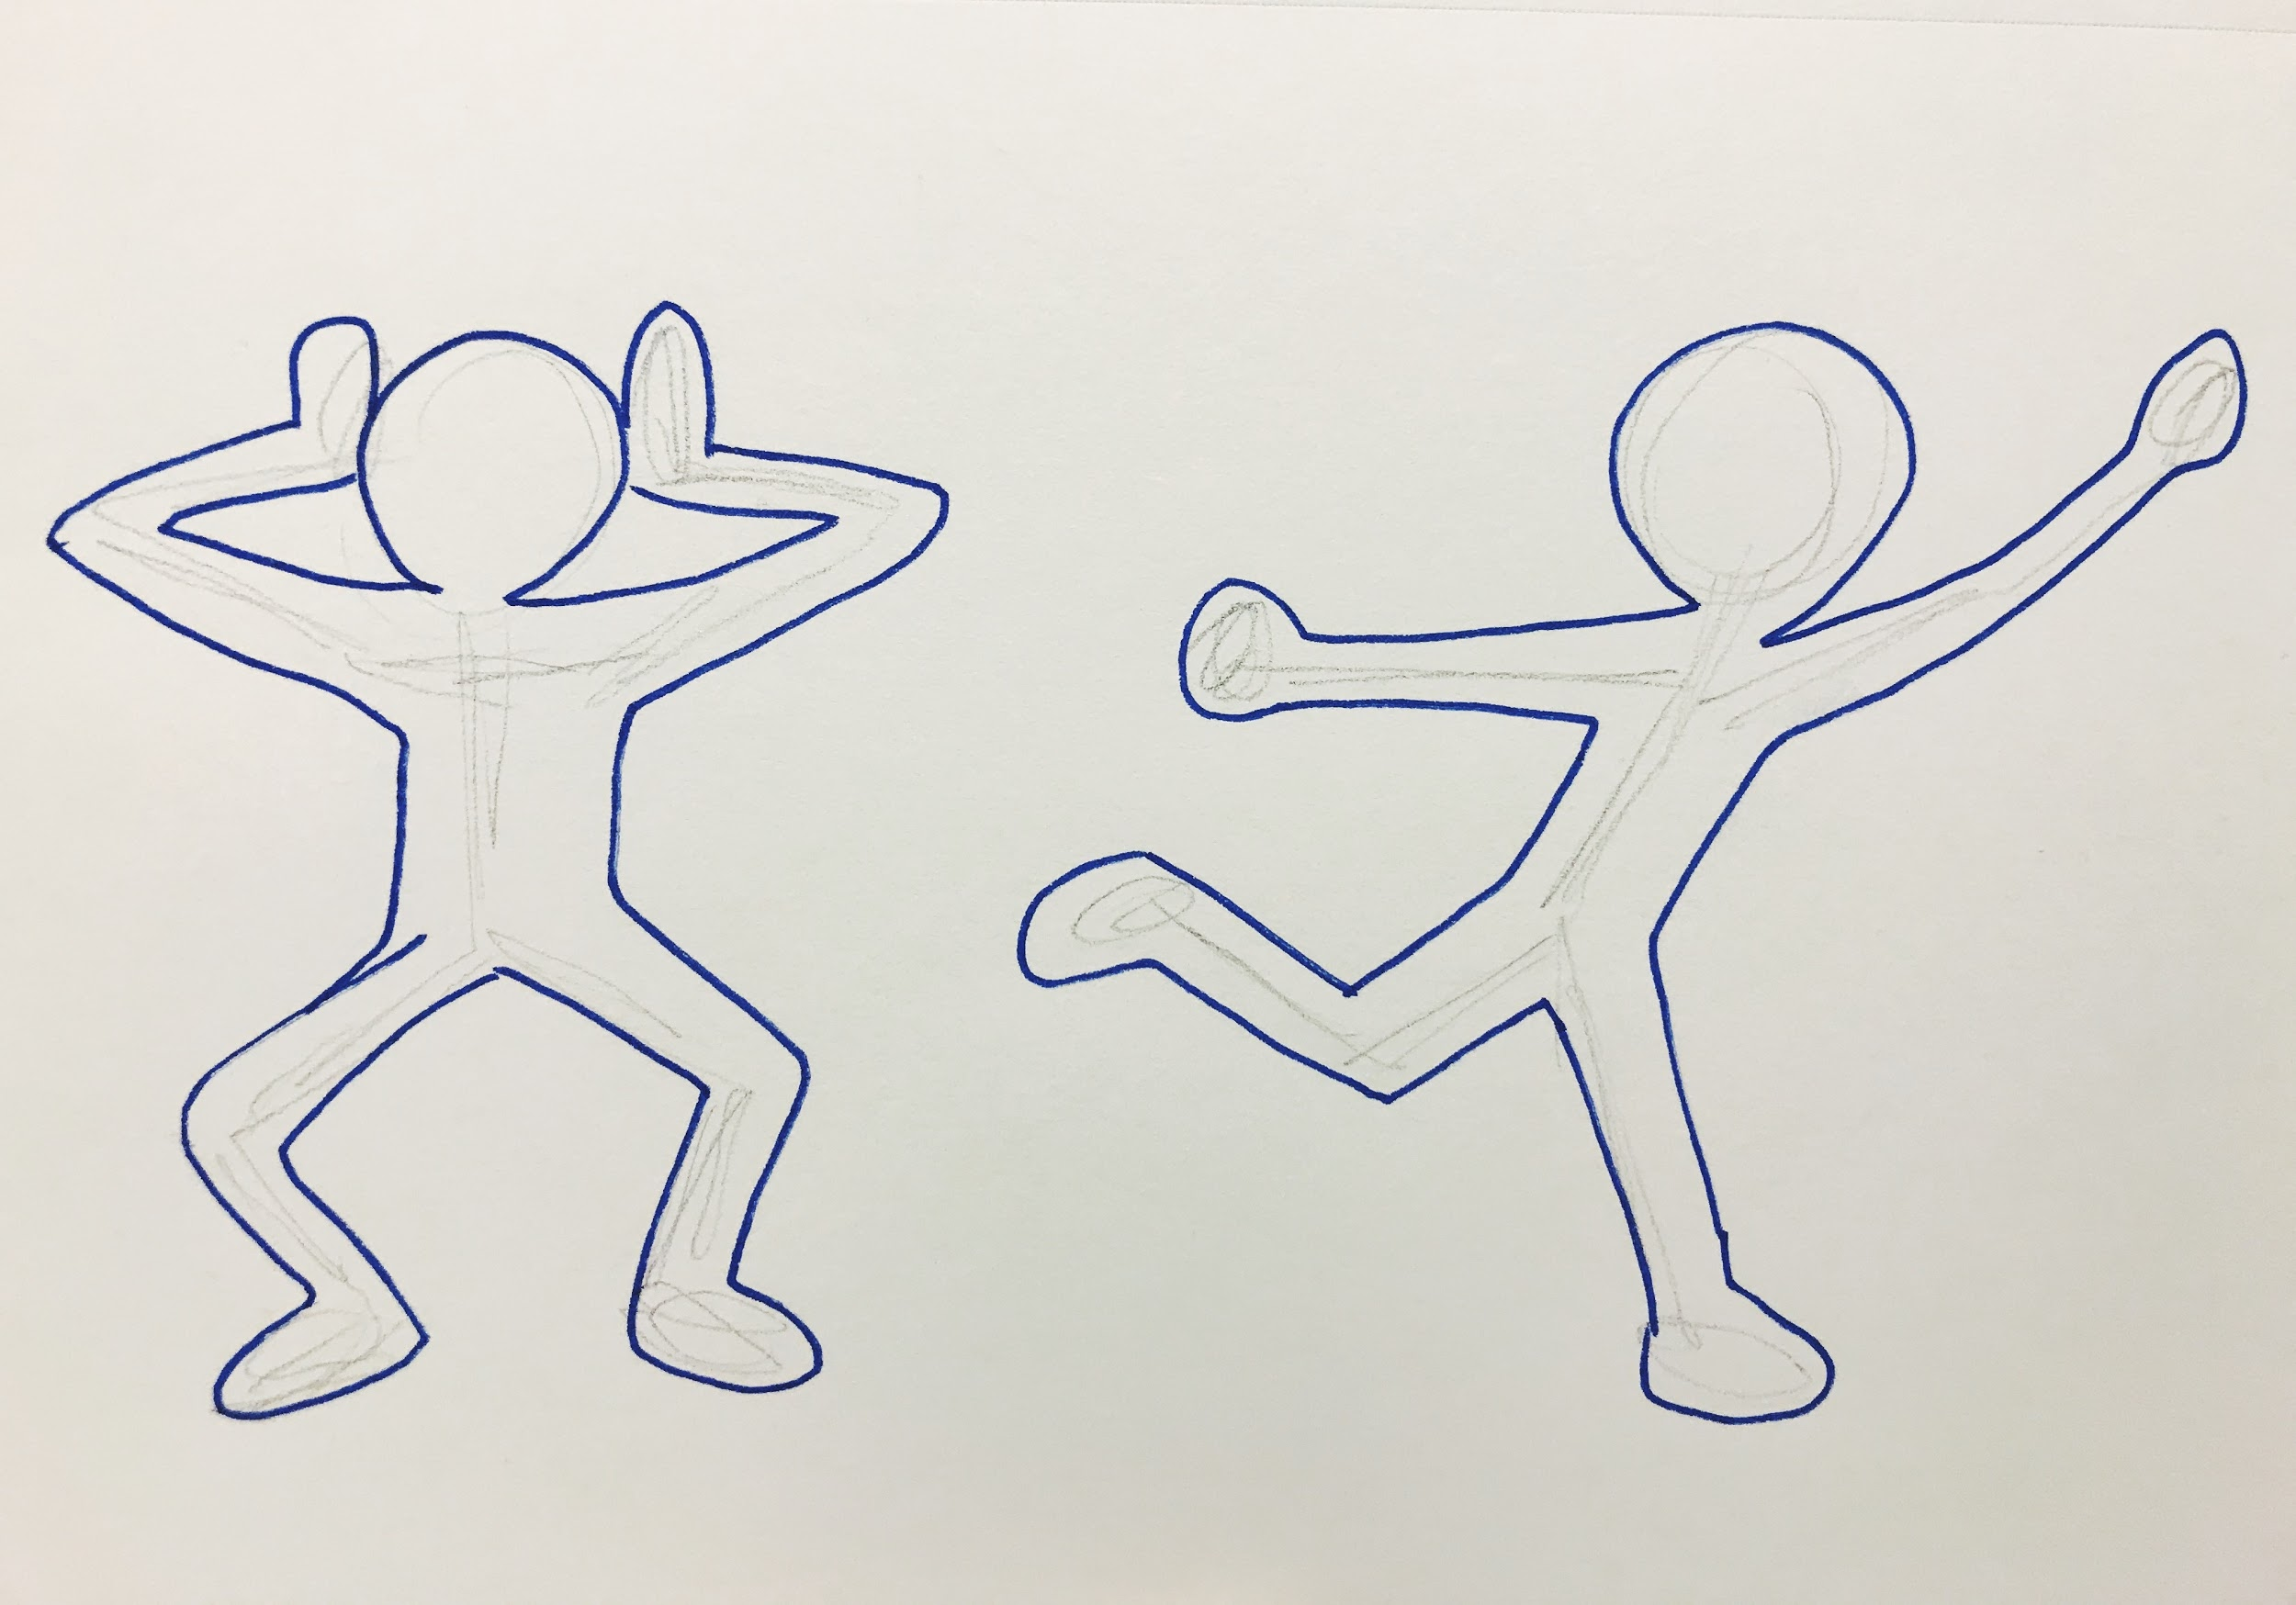

Slide 25
Things to consider: Color
How do each of these colors make you feel?
What do they make you think about?

Slide 26
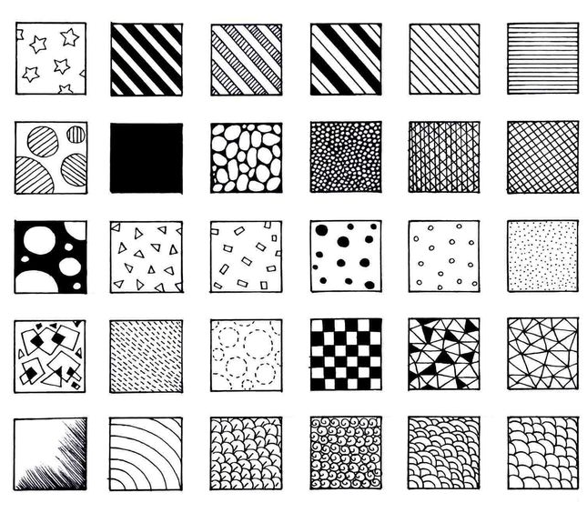
Things to consider: Pattern

Slide 27
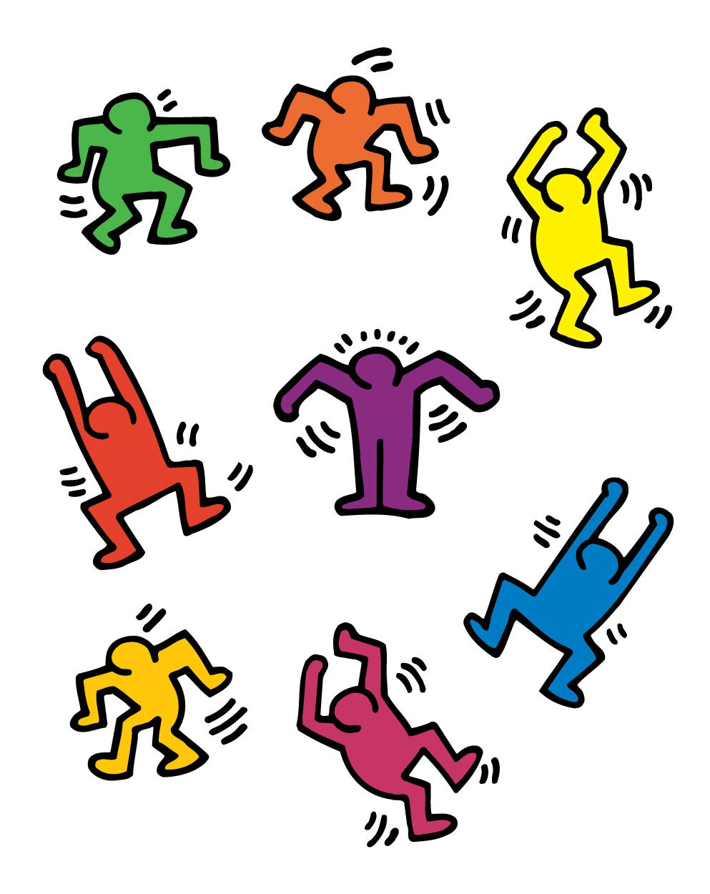
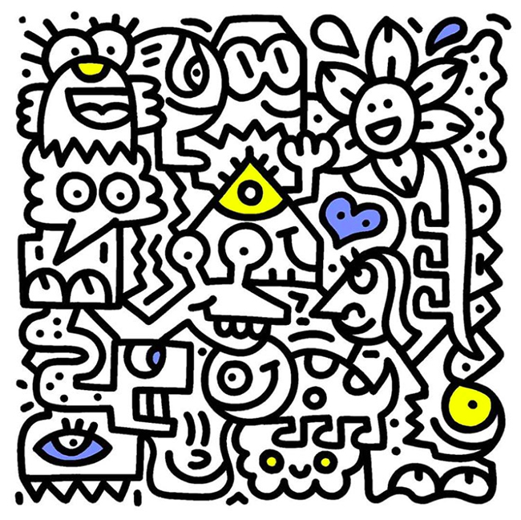
Things to think about: Style

Slide 28
Today's Plan
Step 1: Have a table buddy take 3-5 photos of you expressing an emotion using your whole body
Step 2: Use these photos as reference to sketch 3 thumbnails
Step 3: Select one of these sketches to create on a larger scale
Step 4: Create your figure and cut out with scissors
Step 5: Paint thoughtfully
Step 6: Collage together for classroom mural
Notes:
Sam interact with mural

